Slide 1
EESC - public hearing on Imbalances in social protection in general and specifically for the "new forms of work" and "atypical workers"
Dana-Carmen Bachmann
European Commission (DG EMPL) – Head of Unit - Social Protection Unit

Slide 2
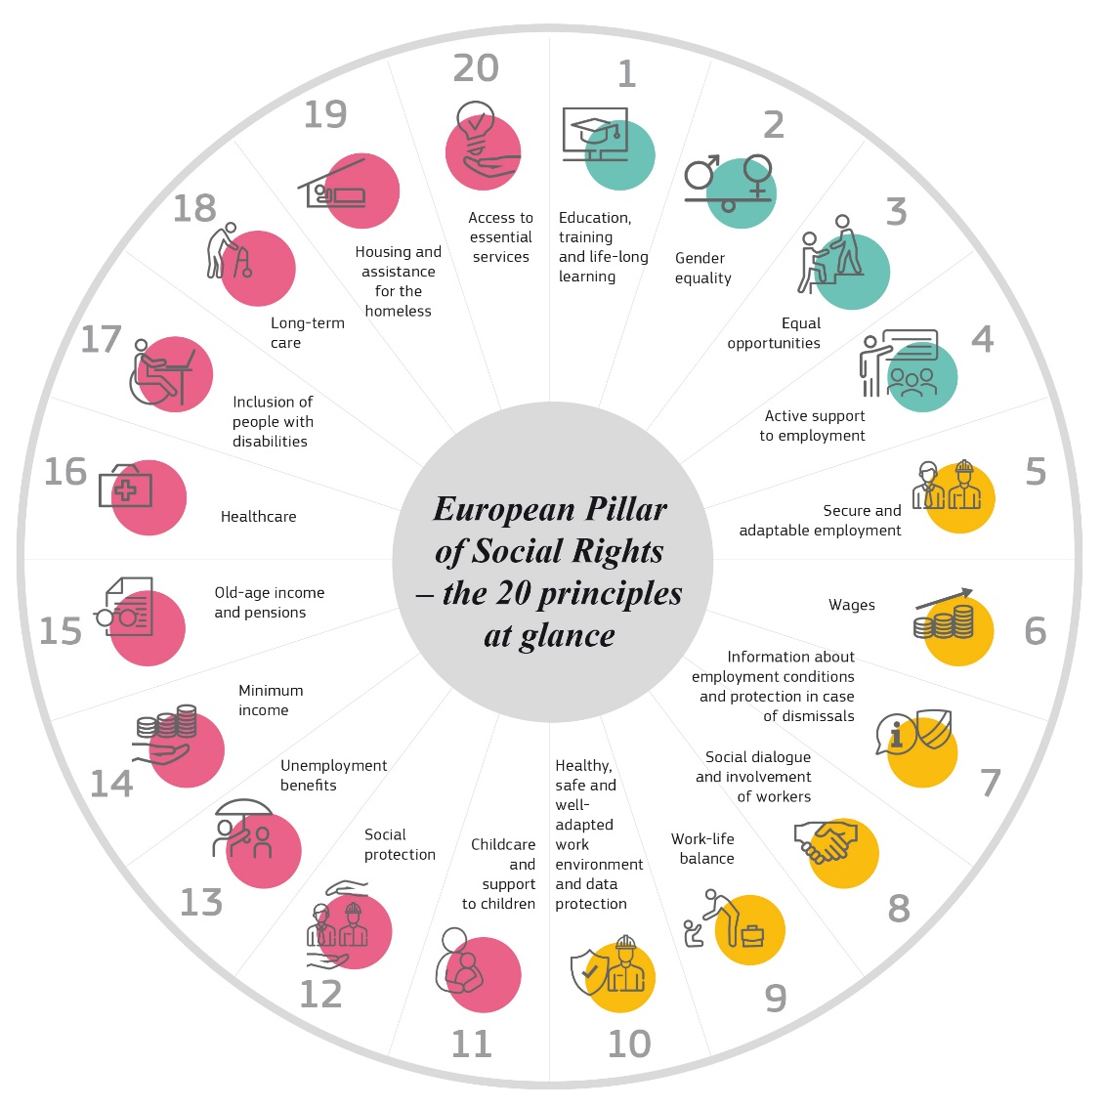
European Pillar of Social rights
EPSR endorsed in 2017, with 20 key principles, guiding towards a strong Social Europe
EU to complement national level incl. Action plan adopted in March 2021 + Porto Social Summit and Declaration
A number of EU proposals over 2020-23 to advance social rights

Slide 3
Access to social protection for workers and the self-employed in the EU

Slide 4
Context: some figures
In 2023, almost 40% of the population in employment in the EU‑27 (78 million people) were in non-standard forms of work i.e. with
a temporary contract (23.6 million),
part-time work (38.1 million)
and/or self-employed: 28 million including 19.9 million solo self-employed (among which around 750,000 ‘dependent self-employed’)
Proportion of people in non-standard forms of work has been stable over the last decade; and situation vary greatly between and within groups
..but some new forms of employment (casual workers, portfolio workers, platform workers) have become more prevalent
28 million people in the EU work through digital labour platforms
Notes:
(no employees + worked during last Y for only 1 (dominant) client, who determined their working hours)

Slide 5
Labour market statuses by Member State (aged 15-74), 2023 (%)
Labour market statuses in EU27, 2023 (%)
Source: EU-LFS (2023), DG EMPL calculations

Slide 6
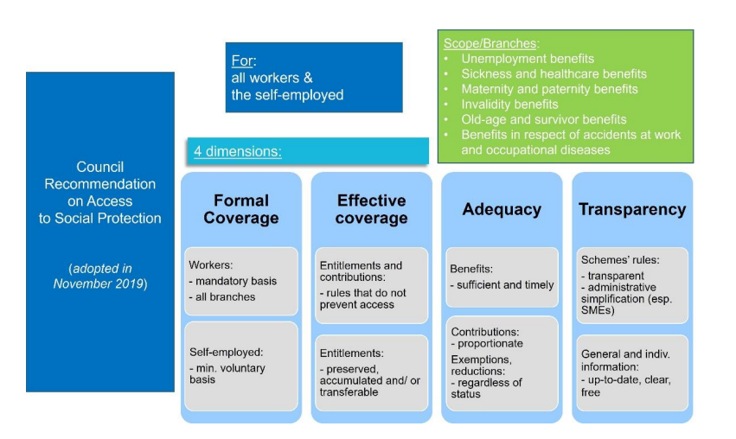
2019 Council Recommendation – main features

Slide 7
Implementation of the Recommendation
New mutual learning events; further implementation; and development of the monitoring framework
Analysis of the plans, consultations of stakeholders and policy exchanges
Adoption by the Council of the EU
Establishment of a monitoring framework (MF)
November
2019
2019- 2020
November 2020
May-Sept 2021
2021-22
Early 2023
2023-2024
Mutual learning workshops
Plans informing about national measures
Report by the European Commission
Update and improvements of the MF

Slide 8
Main conclusions of the report
Large number of workers or self-employed people are still left without sufficient access to social protection
Mixed picture regarding implementation efforts; overall level of ambition varies significantly across Member States
With a few exceptions, most Member States do not aim to address all existing gaps in access to social protection
Starting point is very diverse – logical to see fewer commitments to new structural reforms in Member states with already universal/generous systems
Some ambitious reforms (focused on formal coverage) in half of the Member States…
…but not in a number of Member states where non-standard workers and self-employed are still not (adequately) covered

Slide 9
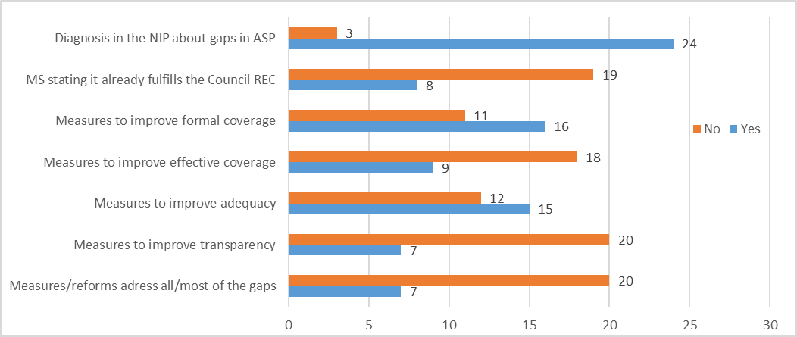
Overview of the 27 national plans (1)
Notes:
As of March 2023, 27 Member States submitted their national plans
Almost all plans refer to existing/remaining gaps in access to social protection – but all gaps/groups are covered only for half of the MSs
Plans rather focused on formal coverage – while other dimensions are less covered (despite existing indicators)
Some MSs consider that they have already implemented all of the Recommendation’s provisions (BG, SE), or almost all (CZ, FR, HU, AT, PL),
Most plans refer to specific measures taken or new commitments at national level to implement the Recommendation but…
..the range and scope of measures, and their timing (already taken or planned) vary considerably
Wide range of social protection branches covered, but the 3 most frequently covered are pensions, unemployment and sickness benefits.
Timing: 13 MSs refer to measures taken since 2019 while 18 MSs refer to measures in preparation/ planned for the future. Some refer to measures taken in the past (i.e. before the adoption of the Recommendation).
Most measures focused on formal coverage (16 MSs) and adequacy (14) - fewer measures addressing effective coverage (9) or transparency (6)
Detailed information on each measure (branch, target group, expected impact, timeline, budget, evaluation, etc) provided only by a few MSs
In most MSs: no evidence of “broad dialogue at national level involving social partners and all other relevant stakeholders”

Slide 10
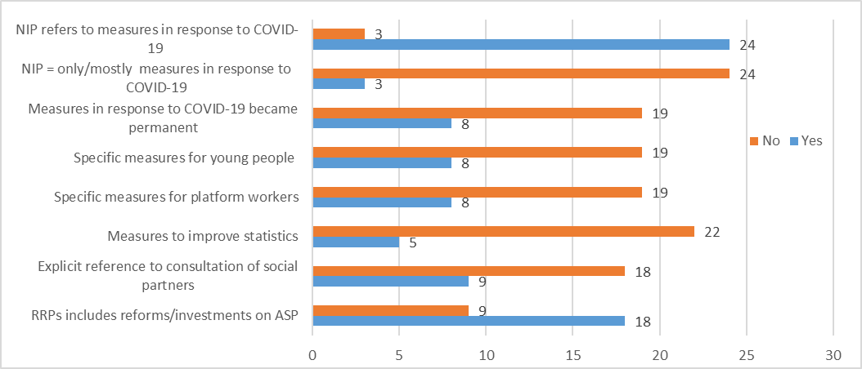
Overview of the 27 national plans (2)

Slide 11
Useful links
Council recommendation (2019) on access to social protection for workers and the self-employed:
National plans
Commission’s Report (2023) on its implementation
ESPN report on transparency (2023) in 35 European countries
Council Recommendation of 30 January 2023 on adequate minimum income ensuring active inclusion
Report of the High-Level group on “the future of social protection and of the welfare state in the EU”
Factsheet
Summary and recommendations in all EU languages
Monitoring framework on access to social protection - and update

Slide 12
Thank you for your attention
Dana-Carmen.BACHMANN@ec.europa.eu
DG EMPL – Head of Unit, Social Protection
European Commission

Slide 13
Extra slides

Slide 14
Formal coverage: some ambitious reforms
Structural reforms in 15 Member states : already adopted in 5 - while planned in 10
For self-employed:
plans to providing/improving access to unemployment in EE, LT, BE (bridging rights);
social insurance coverage in CY, disability insurance in the NL, sickness benefits in EL, paternity benefits in RO
For non-standard workers:
access to unemployment benefits for domestic workers in ES
improvement in coverage for workers from cultural sectors in PT
PL to extend mandatory insurance and improve coverage of civil law contracts;
protection by sickness benefits to employees without a scheme in IE;
RO planning to ensure formal access to all social security branches for seasonal and day workers as well as platform workers

Slide 15
Effective coverage: some policy measures
Gaps in effective access recognised as a challenge in the national plans – but few structural reforms
Majority of measures reported were taken on a temporary basis in response to the COVID 19 pandemic (for instance eligibility conditions loosened for UBs, sickness or income support for self-employed)
Some reforms improving effective coverage:
ES (unemployment assistance)
IT (improved access for non-standard workers)
LT (preparing reform of unemployment insurance)
Little focus in the plans on how to improve transferability of entitlements

Slide 16
Adequacy: focus on some branches
Adequacy is addressed in 16 national plans
Many focussed on improving pensions for the self-employed (BE, ES, FI, LV, PT) or employees with low entitlements (AT, CZ, DE, EE, FR)
Mostly temporary measures to improve the adequacy of unemployment benefits (e.g. duration prolonged or degressivity suspended) – some structural
Only few measures to improve adequacy of other branches (sickness, invalidity, healthcare) reported in the plans
Relatively few measures to improve adequacy of social protection for workers in non-standard jobs (some focused on cultural sector workers)

Slide 17
Transparency
Not much addressed in national plans ..even if there are reforms across the EU to support access to clear and up-to-date information and awareness of social rights, and to simplify procedures
..in many cases through the Recovery and Resilience Plans
Some MSs state that the rules on access to social protection are already clear and transparent and that information is accessible (e.g. BE, EE, FR, HR, MT, SE), with some also highlighting the importance of maintaining/improving this (BE, LU, MT, NL, SE)
Complex dimension to monitor / compare
Analysis based on 2022 ESPN report on transparency (and 35 national reports)

Slide 18
Transparency / Access to information
General and personalised information: trends towards digitalisation (online portals, personal accounts, online tools, information per specific status)
Awareness raising campaigns in 14 EU Member States since 2017 (e.g. in case of reform; to inform about future entitlements, benefits of joining a scheme, COVID-19 measures, etc)
Gaps:
Some information gaps and shortcomings specifically affecting (sub-groups of) non-standard workers and the self-employed (for instance information on voluntary schemes)
Online calculators exist but almost only for pensions
Limited knowledge of sickness, healthcare and old-age benefits
Complex language, outdated information
Access to information for vulnerable groups (people with visual/hearing impairments, older people or homeless people) ; digital divide; physical venues still matter

Slide 19
Transparency / Simplification
Simplification can be done in:
formal rules of a social protection scheme;
administration (institution) structure;
or in the application/receipt process for accessing benefits
Several MSs are simplifying access to general or specific schemes (AT and PT: simpler rules for self-employed); merging benefits into unified schemes or harmonisation of regulation; simplification of contribution payment systems, one stop social security portals; ‘once-only principle’ for data collection, partial automation of data exchange
Application procedures: web portals with integrated functionalities for users and sharing of data among the different institutions; online and pre-filled application procedures (DE, IT, SK); some rare examples of automatic granting of benefits for eligible people in specific branches

