Slide 1

European Network of (ex-)Users and Survivors of Psychiatry (ENUSP) enusp.info@gmail.com / www.enusp.org
Public hearing on SOC/799 "Mental Health Community Services
Panel 1: Views and approaches by international organisations and Lived-experiences and Innovative Practices in MH community services
Ms. Olga Kalina, Chair of ENUSP

Slide 2
Introduction: ENUSP members
36 member organisations
in 28 European countries
Northern Region: Denmark, Finland, Iceland, Norway, Sweden
North East Region: Latvia, Lithuania, Russia, Ukraine
North West Region: Germany, Ireland, the Netherlands, United Kingdom
Central Region: Czech Republic, Moldova, Poland, Romania, Slovakia
South West Region: Belgium, France, Italy, Portugal, Spain
South East Region: Bosnia & Herzegovina, Georgia, Greece, Serbia, Slovenia

Slide 3
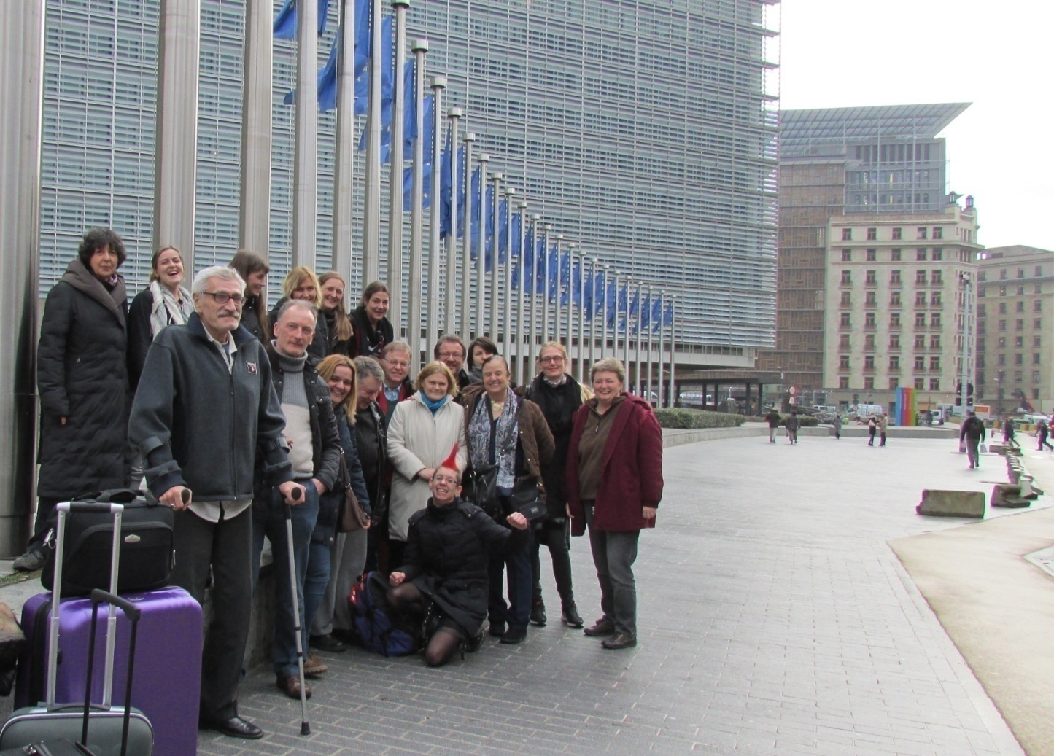
ENUSP Empowerment Seminar 2015, Brussels

Slide 4
Consultations with members
The second review of the EU’s implementation of the UN CRPD by the UN Committee on the rights of persons with disabilities is underway and should take place next year.
The European Network of (Ex-)Users and Survivors of Psychiatry has held thematic consultations via dissemination of questionnaires and online discussions with our members in EU states
Objectives:
Information from members on Improvements
Barriers based on the opinion and lived experiences of ENUSP’s members with regard to their rights in the mental health care system throughout the EU and to discuss our recommendations

Slide 5
Personal experiences related to Articles 14, 15 and 16
France:
“We consider forced hospitalization as violence and abuse, and a cause of severe traumatization… People may come back with sleep problems, nightmares, fear and dissociation (PTSD). Some people may never understand what happened to them and even build false interpretations, because the medical violence they endured is unbelievable.”
Note: 95,473 persons were hospitalized without their consent and 39,244 were under Community Treatment Orders (CTO) in 2021
Germany:
“During my worst psychotic episodes, I was treated like a villain, like an outsider and with force. Examples [of coercive measures] are restraint, giving me medication without my understanding of what I was taking… “

Slide 6
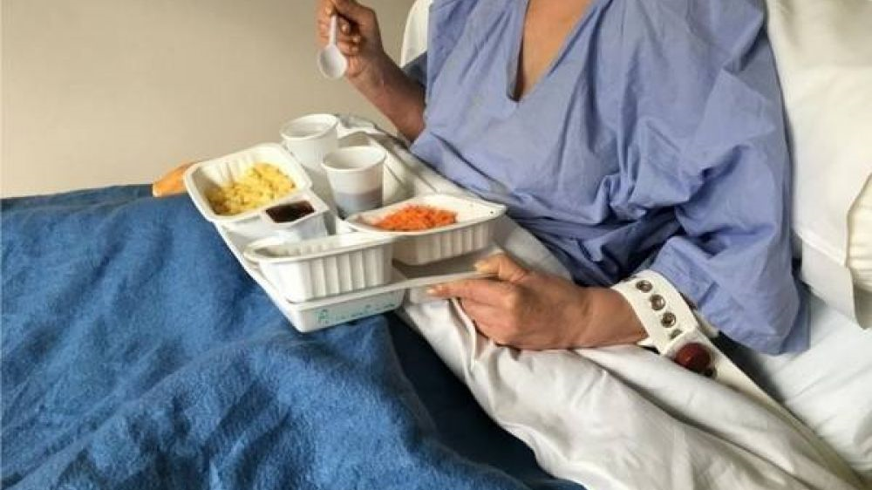
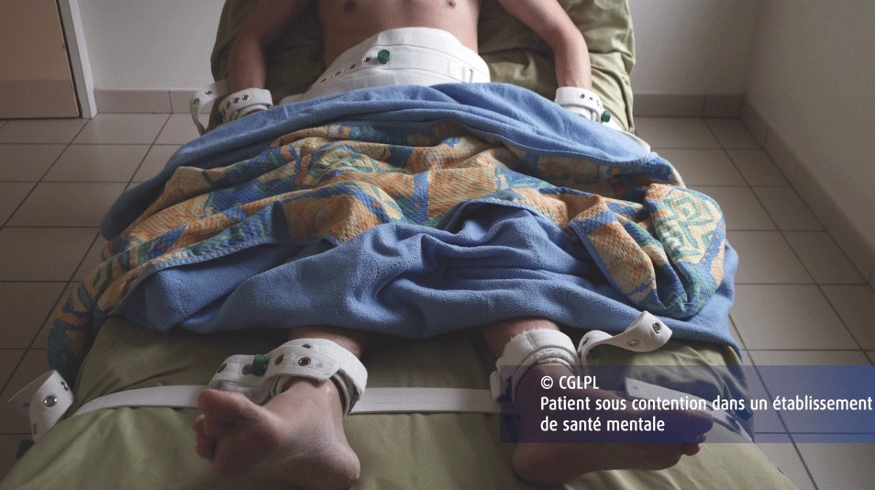
Monitoring: CGLPL Controller general for places of deprivation of liberty, France, photos taken in 2016, 2018

Slide 7
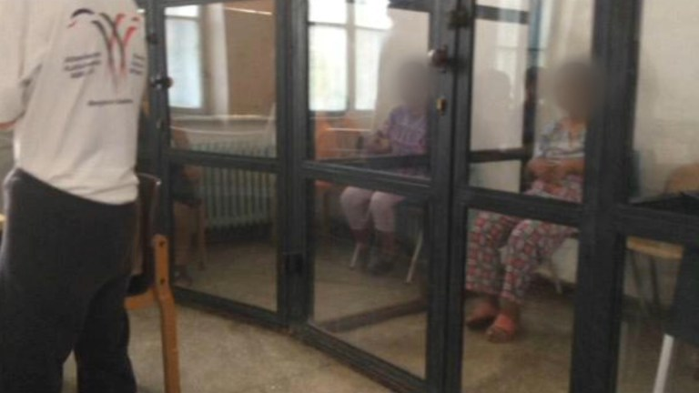
Rehabilitation Center for People with Disabilities, Romania, 2019

Slide 8
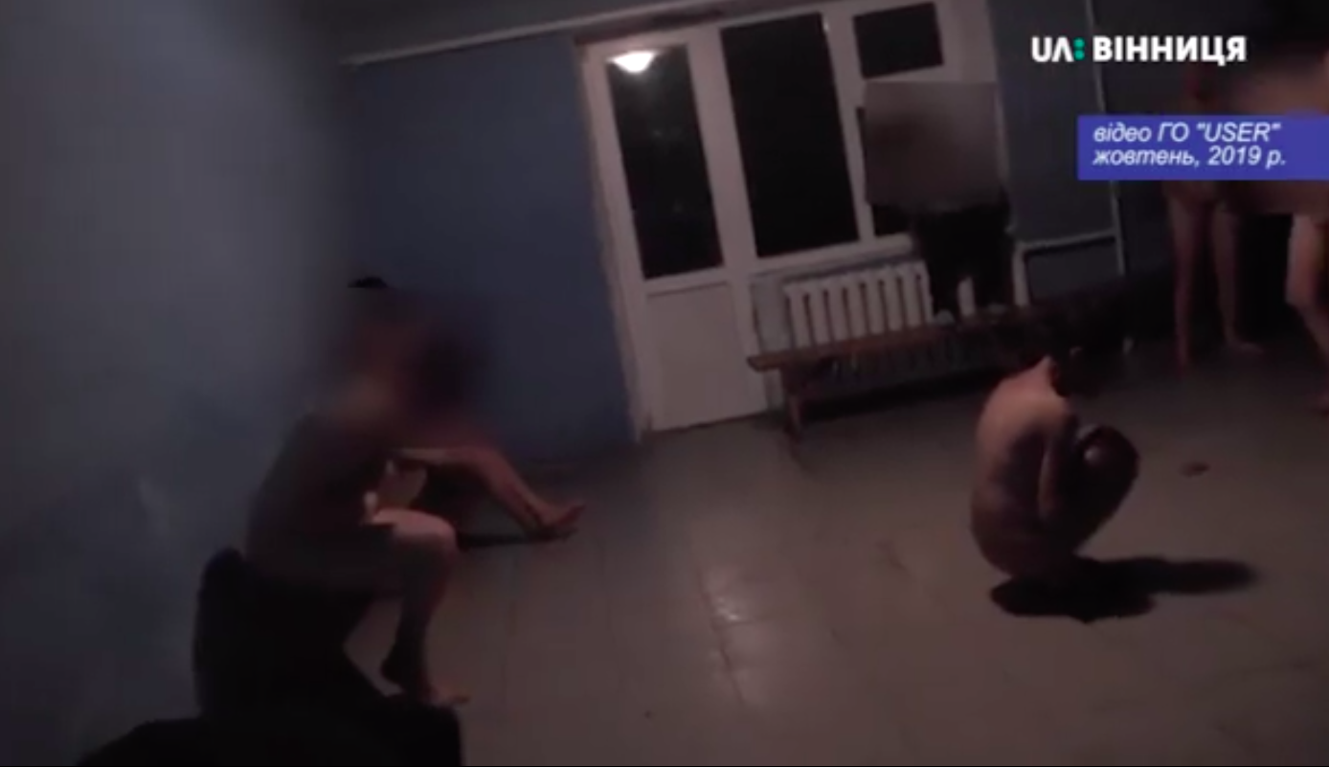
Ukraine, residential facility, October 2019, monitoring by NGO member of ENUSP - “USER”
https://www.facebook.com/watch/?ref=saved&v=937404826659713

Slide 9
Women with disabilities
“I was once forcefully kissed by a man [in a psychiatric institution]. After that a nurse came up to me and asked me to stay away from this man because he has a wife and children. Although I was in a very vulnerable state because of my acute psychosocial disability, I was blamed for the act of sexual harassment.”
“In a clinic where I spent my rehabilitation, there was a special area for women who have suffered from sexual harassment by men to offer them a safe space. That was a very positive experience to see.”
Forced sterilization of persons with disabilities is still explicitly allowed in Bulgaria, Croatia, Cyprus, Czechia, Denmark, Estonia, Finland, Hungary, Latvia, Lithuania, Portugal and Slovakia according to the analysis of the European Disability Forum.
The UK protocol on isolation in mental health departments requires women be placed there without underwear and with no access to toilet paper or menstrual supplies. According to women, sometimes they are undressed and put in isolation rooms by male staff.

Slide 10

Wider consequences of coercion
Lack of trust,
more self-stigma, normalization of violence,
trauma, self-harm, dissociation, suicide, more isolation,
fear of healthcare system,
fear of police,
more vulnerability to violence and threats in order to avoid contact with the system, etc.

Slide 11
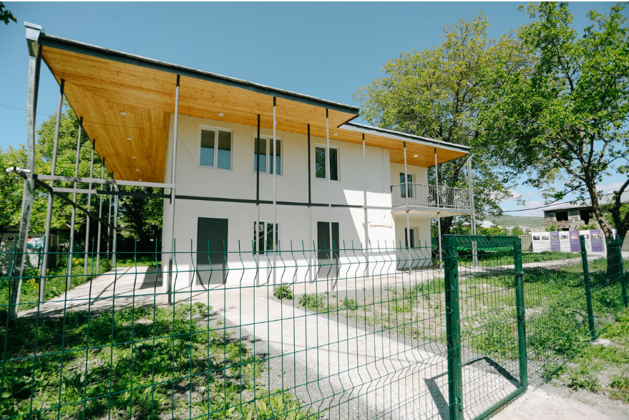
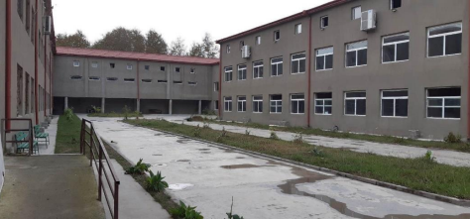
Less obvious forms of coercion
Psychiatric hospitals - small group homes
Any real change in culture?

Slide 12
Alternatives to Coercion
First Principle- Do No Harm
We far too often find MHS dehumanizing and disrespectful of our rights and autonomy. Or unable to meet our needs!
Staff attitudes
Firstly, some people should never work with marginalized, vulnerable people- and yet all of us have encountered abusive individuals, and most with too much power, who do damage
Secondly, it is morally mandatory that staff get on board to recognize their sane privilege and learn how to be genuine allies in the work of eliminating coercive power over our lives, bodies and mental distress experiences.
Hence, we survivors, collaborate in initiatives to help build staff agency to make services more human rights focused and literate.
Share resources equitably and support independent peer spaces.

Slide 13
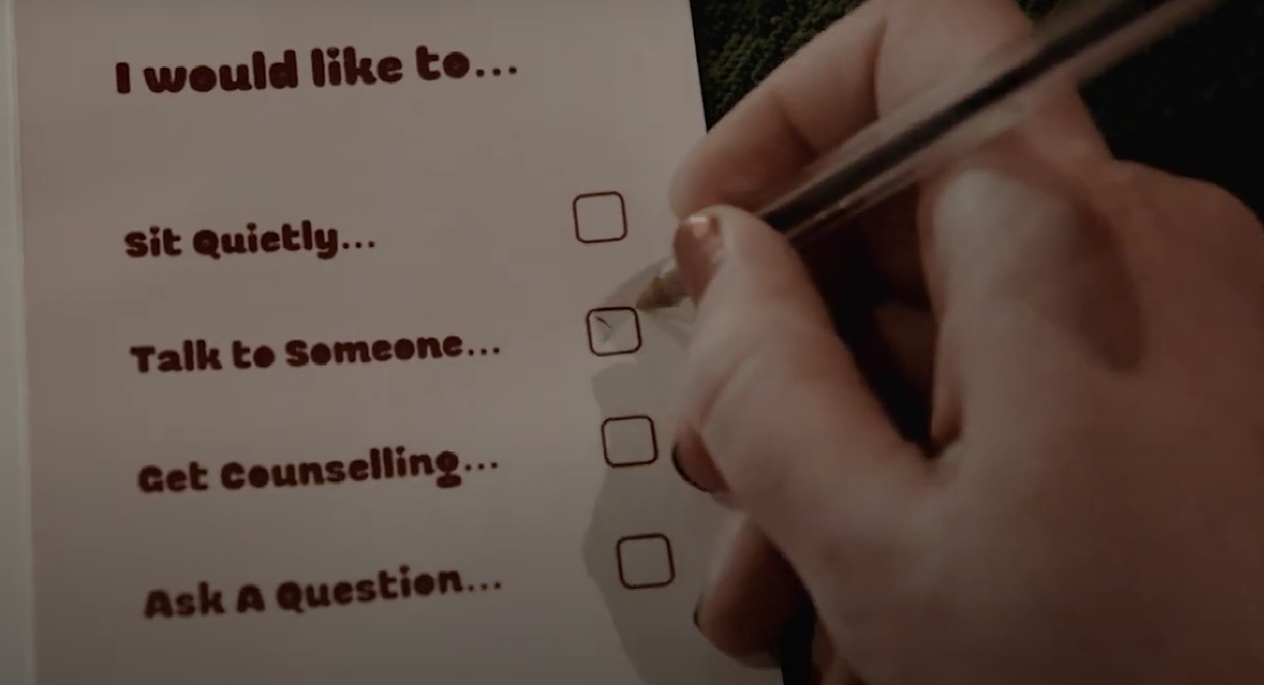
Peers and respites
Respite Houses Wildflower Alliance, Massachusetts USA: https://wildfloweralliance.org/afiya
Leeds 24/7 crisis house UK https://leedsoasis.com/
The person is in control of their journey in these spaces.
Galway Community Café - https://youtu.be/6UjpaReSIck?si=DNyQV0Z9A6RgmZld

Slide 14

WHO framework for meaningful engagement
Importantly, individuals with lived experience should no longer be excluded from the solutions that impact their health and well-being.
Stakeholders in global public health should therefore find new forms of multistakeholder collaboration to develop effective, contextually appropriate solutions to accelerate action and improve health outcomes.

Slide 15
Is the EU really “walking the talk”?
“Communication from the Commission to the European Parliament, the Council, the European Economic and Social Committee and the Committee of the Regions on a comprehensive approach to mental health” (June 2023)
Lack of involvement of stakeholders
Gap between “mental health” and “disability” related topics
Our true priorities not focused on – ex. “loneliness” versus eliminating coercion, full and equal legal capacity, training of professionals on human rights
Evaluation: which indicators/criteria – who decides?
- Understanding of “last resort” measures as a norm – discourages research and funding needed to scale up new/alternative good practices

Slide 16
Equitable inclusion of individuals with lived experience in a range of processes and activities within an enabling environment where power is transferred to people; valuing lived experience as a form of expertise and applying it to improve health outcomes.
Our participation will make the difference – “user/survivor-led”
Be aware of instrumentalization - Not a token role!
Leaving the role of “poor sick person needing protection" to always being an active and involved "citizen".

Slide 17

European Network of (ex-)Users and Survivors of Psychiatry (ENUSP)
Thank you for your attention!
E-mail: enusp.info@gmail.com Website: www.enusp.org

