Slide 1
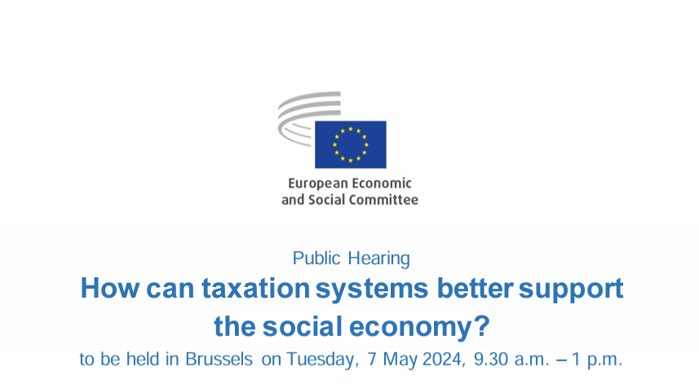
Mapping social economy entities
María Pilar Alguacil Marí
Full Professor Tax Law
University of Valencia
Chair of Agricultural cooperatives

Slide 2
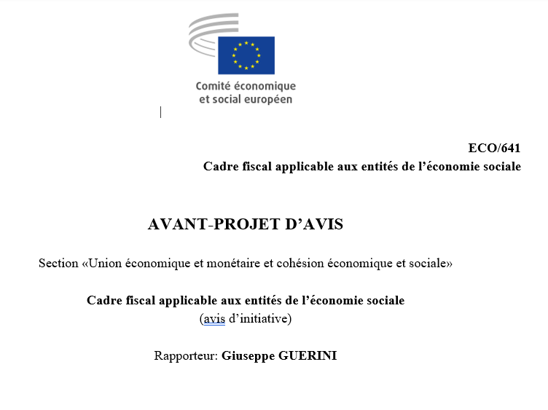
What we will talk about
The Economic and Social Committee is working on an own-initiative opinion on the taxation of the social economy in Europe.
My presentation will be limited to the taxation of cooperatives in the context of corporate taxation.

Slide 3
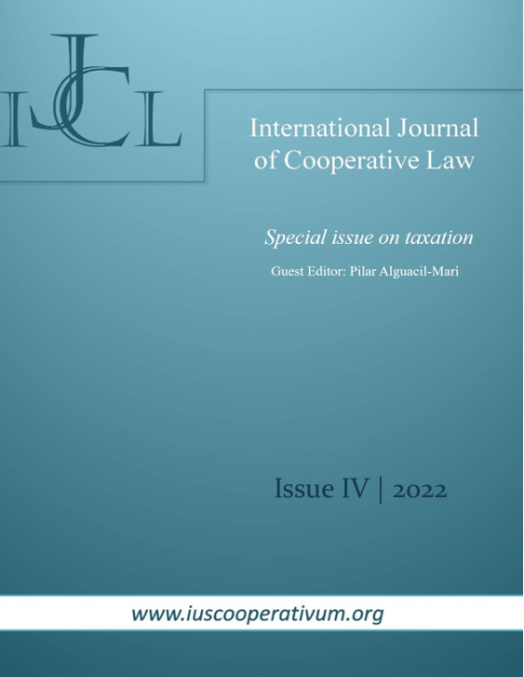
In 2022 we published a special issue of the International Journal of Cooperative Law, dedicated to the taxation of cooperatives, which I recommend reading for those interested in the subject, as it includes a review of comparative law, as well as in-depth studies of the different models.

Slide 4
Why an special treatment for co-operatives? Why to harmonize it?

Slide 5
Why an special treatment?
Co-operatives are different
Non profit
Only in case they are dealing in exclusive with members
General interest goals
National level : Constitution
European level: Treaties, social values

Slide 6
How this special treatment should be?
Tax treatment
2 diferente levels and criteria
Ability to pay/Equality
Technical rules
Social goals
Incentives
Need to adapt the corporation tax
Saving public budgets

Slide 7
Ability to pay
Mutuality: The co-operative is not interested in earnings to deliver to its members, but in increase the members savings or revenue by their activity
So, the member’s ability to pay, not co-operative
Members are clientes, workers or providers
This carries us out to tax treatment of surplus or returns

Slide 8
Taxation of surplus in Europe. Models
systems that apply the general tax regime to cooperatives without taking into account their peculiarities, as is the case in Ireland and Austria;
systems that apply the method of exempting the results obtained with members for the cooperative. The exemption is combined either with a system of fiscal transparency or imputation of incomes to members. Also, with taxation of the profit received as a dividend by the member. This tends to be the case only for certain cooperatives, in countries such as Greece, Germany and Portugal, among others.
those that deduct the return from the cooperative's tax base, as in Italy and the United Kingdom, in some cases;
those that treat the distributed profits as a dividend and apply a lower tax rate to the cooperative, including Spain and Portugal.
Even these consider the payment to members as an expense of the co-operative, so the treatment is similar.

Slide 9
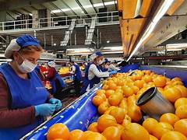
Valuation of dealings with member
It should be borne in mind that the determination of the amount of the return, and therefore of the deductible item in the cooperative's tax base, will depend to a large extent on the value we establish for the transaction (purchase, sale, service) carried out with the member.
The amount will depend on this valuation (effective price or transfer price).

Slide 10
Special Funds
Cooperatives may be required to set up internal funds or reserves for two purposes:
- To maintain solvency, given the financial fragility of variable share capital.
- To contribute to the promotion of co-operativism or other purposes of solidarity.
In addition, they must remunerate the share capital, since it is not remunerated by the distribution of dividends.
Cooperatives distribute their profits on the basis of the activity carried out, and not on the basis of the capital contributed, and must therefore establish another form of remuneration, which is usually in the form of a limited interest rate.

Slide 11
Tax treatment
On the other hand, there are countries that consider that the interest paid on capital should be an expense deductible from the cooperative's taxable income. This is consistent with countries that treat the return as a dividend.
Many countries have an special treatment for endowments to mandatory funds: they are deductible in the tax base, or have a reduction, etc.

Slide 12
Technical issues to be harmonized
Taxation of surplus
Valuation of dealings with members
Special Funds
Limited interest in capital

Slide 13
Social goals
The way it works improves the market
They work in social sensitive áreas: work, housing, care, agri-food, consumer…
They accomplish general interest goals
The state expense is disminished

Slide 14
State aid
The Court's decision was based on the compliance of national legislation regulating cooperatives with:
- The principles of the International Co-operative Alliance,
- The constituent elements of the European cooperative in Council Regulation (EC) No 1435/2003 of 22 July 2003 on the Statute for a European Cooperative Society (SCE).
- The criteria listed in the Communication from the Commission to the Council, the European Parliament, the European Economic and Social Committee and the Committee of the Regions on the promotion of co-operatives in Europe /* COM/2004/0018 final */.
The ruling of the European court understood that the tax incentives were not incompatible with the single market and that each exemption established will have to be studied in the light of the State aid regulations in order to determine its compatibility with art. 107 TFUE.
PAINT GRAPHOS AND OTHERS
JUDGMENT OF THE COURT (First Chamber)
of 8 September 2011
In Joined Cases C-78/08 to C-80/08,
This State Aid doctrine makes us see that harmonisation of some incentives would be possible as long as it is applied to cooperatives that meet these criteria

Slide 15
So…
Harmonisation of the technical aspects of the tax treatment of cooperatives would be desirable.
Harmonisation of the incentive aspects would be possible
However, harmonisation in the area of direct taxation is very difficult at EU level.

Slide 16
Procedure
Unanimity rule in direct taxation
Proposals
«Proposal for a council directive on Business in Europe: Framework for Income Taxation»
Proposal for a COUNCIL DIRECTIVE on transfer pricing
They have not taken notice of the specificities of co-operatives

Slide 17
Thanks
Pilar Alguacil
alguacil@uv.es

