Slide 1
Social Investments for Resilient Economies and Societies: EU Fiscal Rules Fit for Future
Enrico Giovannini
University of Roma “Tor Vergata”

Slide 2
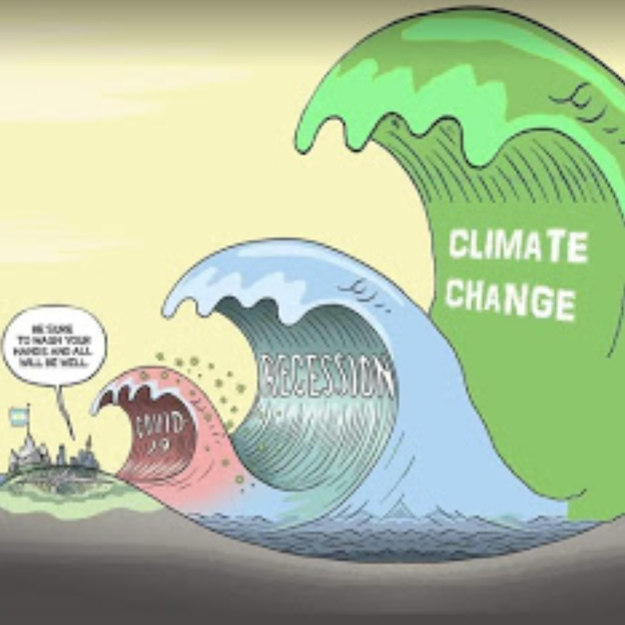


Slide 3

The 2030 Agenda
The UN Global Agenda and the Sustainable Development Goals (SDGs):
17 Goals
169 Targets
240+ indicators
An integrated vision of development, based on four pillars: Economy, Society, Environment, Institutions
Three principles:
Integration
Universality
Participation

Slide 4
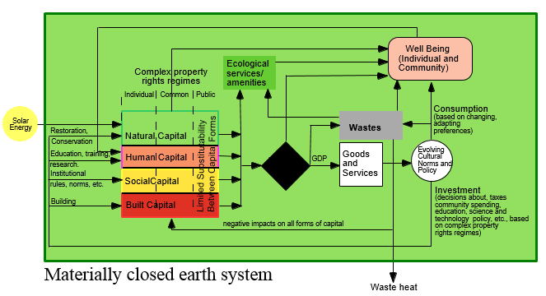

















A new development paradigm
Sociosystem services
Production
process

Slide 5

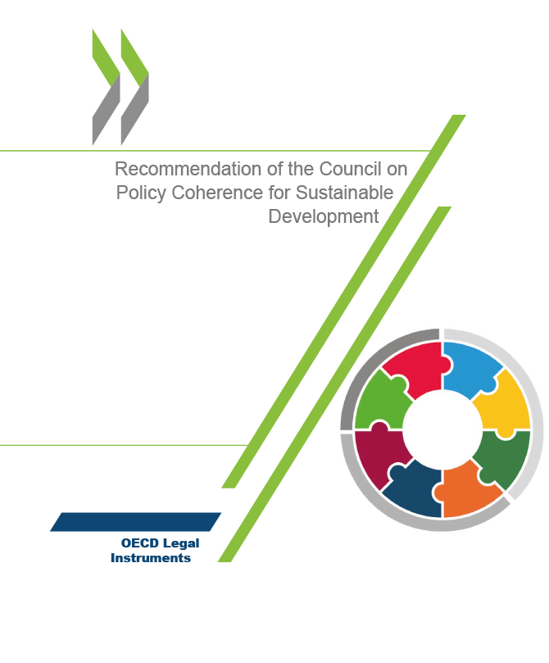
The challenge of policy coherence
Defining, implementing and communicating a strategic long-term vision that supports policy coherence and orients the government and stakeholders towards common sustainable development goals. To this end, Adherents should, as appropriate:
Develop a strategic long-term vision that defines desired sustainable development outcomes, scenarios and actions to enhance coherence across sectors and government levels, and between external and domestic policies in areas that are likely to affect developing countries;
Use existing tools such as strategic foresight, scenario development and systems thinking approaches in the formulation and implementation of policies, to identify, prevent and mitigate actual and potential adverse impacts on the wellbeing and sustainable development prospects of future generations.
Notes:
resilience is multidimensional and shock dependent
- One of the key features of our framework is the distinction between different capacities that the system may use in reacting to a shock/change. Trying to absorb such shocks and changes and go back to previous state is not the only strategy available and might not be the best one. Depending on the type of shock, on its characteristics the system may better adopt different reaction capacities.
- The two main dimensions of disturbances (both shocks and structural changes) (and hence the resilience to them) are intensity and persistence –This Figure shows the joint role of the two dimensions in identifying the capacity required to sustain a resilient behavior.
- The reaction of the system nay take place by either resisting (absorptive capacity), is shock is not too strong in intensity and persistence, or by adopting a degree of flexibility and making small changes to the system (adaptive capacity), if shock is stronger and persists longer, or, at the limit, when disturbances are severe, it is the ability to undergo a deeper change or transformation (transformative capacity).
Examples:
absorptive capacity relates to stability and resistance, agents absorb the impact of shocks without changing their behavior. E.g. in the financial crisis this is financial support to banks
adaptive capacity requires flexibility, and involves incremental changes to allow agents to continue functioning. E.g. financial crisis this is creating a safety net with BU.
transformation happens when other capacities are not enough. E.g. financial crisis this is creating capital markets union. Transformation is the means of learning from past events and engineering changes to better conditions given the current constraints. It is the opportunity to better handle future crisis
- Different policy actions stimulate different capacities. The JRC framework aims at supporting policy makers in identifying the most effective policy measures, including interventions that help the society to adapt and ultimately transform if needed.
prevention
preparation
promotion
protection
transformation

Slide 6

Resilience as “new compass” for EU policies
The central theme of this first report is resilience, which has become a new compass for EU policies with the COVID-19 crisis. Resilience is the ability not only to withstand and cope with challenges but also to undergo transitions in a sustainable, fair, and democratic manner. Resilience is necessary in all policy areas to undergo the green and digital transitions, while maintaining the EU’s core purpose and integrity in a dynamic and at times turbulent environment. A more resilient Europe will recover faster, emerge stronger from current and future crises, and better implement the United Nations’ Sustainable Development Goals.
EC 2020 Strategic Foresight Report
“Charting the Course Towards a More Resilient Europe”
Notes:
resilience is multidimensional and shock dependent
- One of the key features of our framework is the distinction between different capacities that the system may use in reacting to a shock/change. Trying to absorb such shocks and changes and go back to previous state is not the only strategy available and might not be the best one. Depending on the type of shock, on its characteristics the system may better adopt different reaction capacities.
- The two main dimensions of disturbances (both shocks and structural changes) (and hence the resilience to them) are intensity and persistence –This Figure shows the joint role of the two dimensions in identifying the capacity required to sustain a resilient behavior.
- The reaction of the system nay take place by either resisting (absorptive capacity), is shock is not too strong in intensity and persistence, or by adopting a degree of flexibility and making small changes to the system (adaptive capacity), if shock is stronger and persists longer, or, at the limit, when disturbances are severe, it is the ability to undergo a deeper change or transformation (transformative capacity).
Examples:
absorptive capacity relates to stability and resistance, agents absorb the impact of shocks without changing their behavior. E.g. in the financial crisis this is financial support to banks
adaptive capacity requires flexibility, and involves incremental changes to allow agents to continue functioning. E.g. financial crisis this is creating a safety net with BU.
transformation happens when other capacities are not enough. E.g. financial crisis this is creating capital markets union. Transformation is the means of learning from past events and engineering changes to better conditions given the current constraints. It is the opportunity to better handle future crisis
- Different policy actions stimulate different capacities. The JRC framework aims at supporting policy makers in identifying the most effective policy measures, including interventions that help the society to adapt and ultimately transform if needed.
prevention
preparation
promotion
protection
transformation

Slide 7
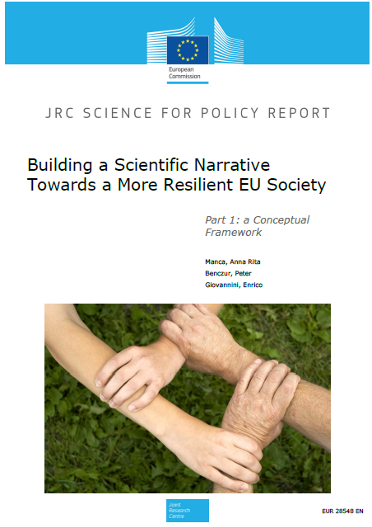
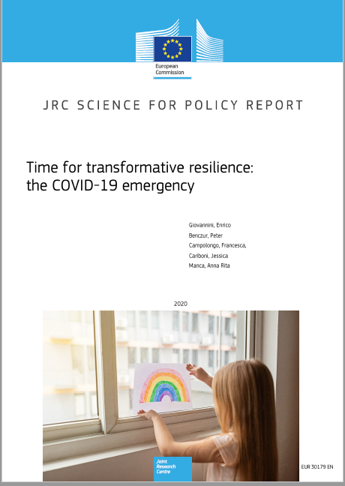
The JRC research on resilience
Notes:
resilience is multidimensional and shock dependent
- One of the key features of our framework is the distinction between different capacities that the system may use in reacting to a shock/change. Trying to absorb such shocks and changes and go back to previous state is not the only strategy available and might not be the best one. Depending on the type of shock, on its characteristics the system may better adopt different reaction capacities.
- The two main dimensions of disturbances (both shocks and structural changes) (and hence the resilience to them) are intensity and persistence –This Figure shows the joint role of the two dimensions in identifying the capacity required to sustain a resilient behavior.
- The reaction of the system nay take place by either resisting (absorptive capacity), is shock is not too strong in intensity and persistence, or by adopting a degree of flexibility and making small changes to the system (adaptive capacity), if shock is stronger and persists longer, or, at the limit, when disturbances are severe, it is the ability to undergo a deeper change or transformation (transformative capacity).
Examples:
absorptive capacity relates to stability and resistance, agents absorb the impact of shocks without changing their behavior. E.g. in the financial crisis this is financial support to banks
adaptive capacity requires flexibility, and involves incremental changes to allow agents to continue functioning. E.g. financial crisis this is creating a safety net with BU.
transformation happens when other capacities are not enough. E.g. financial crisis this is creating capital markets union. Transformation is the means of learning from past events and engineering changes to better conditions given the current constraints. It is the opportunity to better handle future crisis
- Different policy actions stimulate different capacities. The JRC framework aims at supporting policy makers in identifying the most effective policy measures, including interventions that help the society to adapt and ultimately transform if needed.
prevention
preparation
promotion
protection
transformation

Slide 8
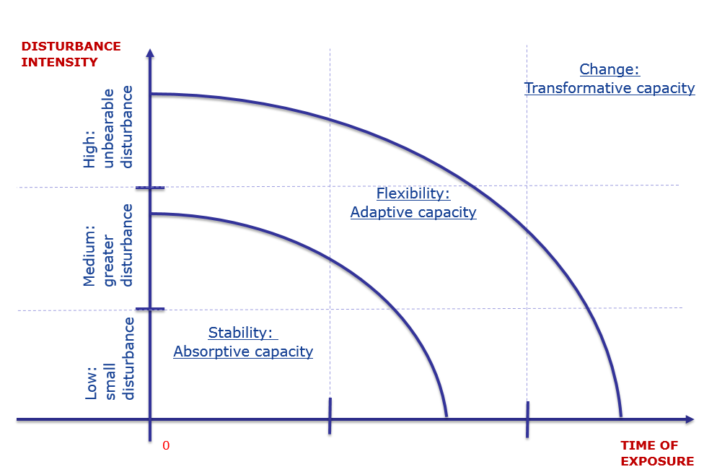




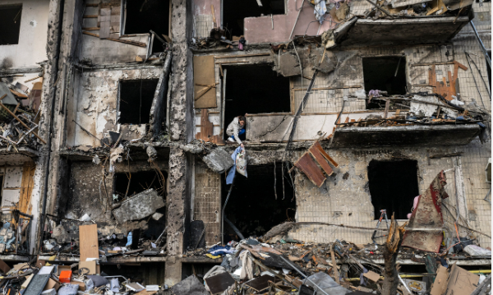
Time and resilience capacities
EU 2020
EU 2022
EU 20??
Is just bad luck?
EU 2015
EU 2010
EU 2008
Economic governance rules
Notes:
resilience is multidimensional and shock dependent
- One of the key features of our framework is the distinction between different capacities that the system may use in reacting to a shock/change. Trying to absorb such shocks and changes and go back to previous state is not the only strategy available and might not be the best one. Depending on the type of shock, on its characteristics the system may better adopt different reaction capacities.
- The two main dimensions of disturbances (both shocks and structural changes) (and hence the resilience to them) are intensity and persistence –This Figure shows the joint role of the two dimensions in identifying the capacity required to sustain a resilient behavior.
- The reaction of the system nay take place by either resisting (absorptive capacity), is shock is not too strong in intensity and persistence, or by adopting a degree of flexibility and making small changes to the system (adaptive capacity), if shock is stronger and persists longer, or, at the limit, when disturbances are severe, it is the ability to undergo a deeper change or transformation (transformative capacity).
Examples:
absorptive capacity relates to stability and resistance, agents absorb the impact of shocks without changing their behavior. E.g. in the financial crisis this is financial support to banks
adaptive capacity requires flexibility, and involves incremental changes to allow agents to continue functioning. E.g. financial crisis this is creating a safety net with BU.
transformation happens when other capacities are not enough. E.g. financial crisis this is creating capital markets union. Transformation is the means of learning from past events and engineering changes to better conditions given the current constraints. It is the opportunity to better handle future crisis
- Different policy actions stimulate different capacities. The JRC framework aims at supporting policy makers in identifying the most effective policy measures, including interventions that help the society to adapt and ultimately transform if needed.
prevention
preparation
promotion
protection
transformation

Slide 9
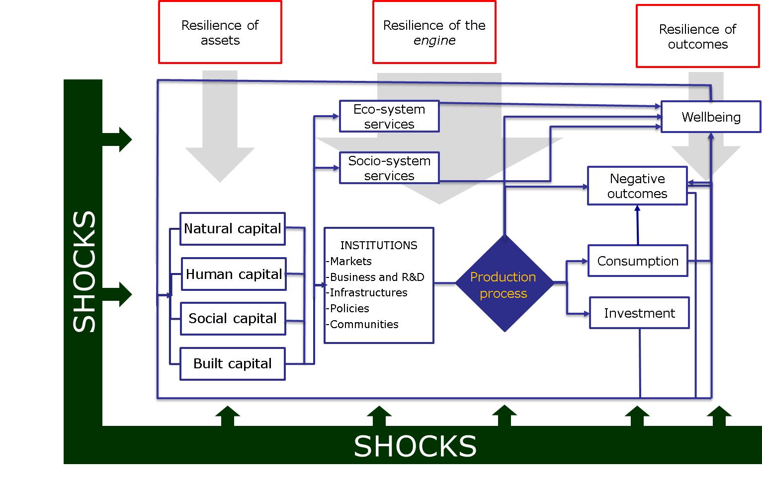
A system view
Economic governance rules
Economic governance rules
Social investments
Social investments
Social investments
Green and digital transition
Extending the materially closed Earth system of Costanza et al. (1997)
Notes:
An important element of our conceptual framework is what we call "the system view".
- This figure shows a schematic visualization of our earth system or if we wish of our society, which is inspired by the “materially closed Earth system” model of Costanza (1997).
There are three main blocks: the first is assets (the four capitals), the second is outcomes (the target variables such as societal wellbeing, investment, consumption and waste), while the third is the “engine” of our entire socio-economic, political and environmental system, connecting assets with outcomes.
This engine includes eco system services, socio system services, and institutions in a very general sense (markets, infrastructures, businesses and research, policies and communities), shaping the production process and utilizing the available capitals to produce outputs.
- Shocks typically affect the inputs (capital stocks), and then the effects interact inside the engine. Using this structure, one can look at the resilience at the level of inputs (capitals), outputs (final outcomes, in particular wellbeing), and various ingredients of the engine.
The concept of the system view is that one cannot have the resilience of outcomes without that of assets and the engine. Although the ultimate object of interest is the resilience of outcomes (societal wellbeing), it is difficult to measure, obseve or even enhance directlty. And the outcomes cannot be resilient if the ingredients are not! This is why we are putting this system view into the center of the framework.
- So, before moving into how to use this conceptual framework, how to operationalise it, to make it a useful tool for policy making let me recall its main conceptual elements:
- Individual centric (societal resilience)
- Bouncing forward (not only stability)
- System view (resilience of all system components)
Natural Capital can be defined as the world's stocks of natural assets which include geology, soil, air, water and all living things.
Human capital is defined as the stock of knowledge, habits, social and personality attributes, including creativity, embodied in the ability to perform labor so as to produce economic value.
Social capital Social capital refers to the collective value of all "social networks". The OECD defines social capital as “networks together with shared norms, values and understandings that facilitate co-operation within or among groups”.
Built capital is defined as any pre-existing or planned formation that is constructed or retrofitted to suit community needs. (In other words, it is any human-made environment.)

Slide 10
Bouncing back …
Societal well-being
A
B
t₀
t₁
Time
Notes:
We also see the issue of steering – improve the well-being properties of the new sustainable path
And yes, there can be an important trade-off between better steering (future) and more “bounce back” (present)
But avoiding paths like the thick black line should be central.

Slide 11
… or bouncing forward?
Moving to a new sustainable development path
Societal well-being
Original, unsustainable development path
New sustainable development path
A
B
t₀
t₁ t₂
Time
Notes:
We also see the issue of steering – improve the well-being properties of the new sustainable path
And yes, there can be an important trade-off between better steering (future) and more “bounce back” (present)
But avoiding paths like the thick black line should be central.

Slide 12
Bouncing forward with steering
Influencing the new SD path
Societal well-being
New sustainable development path
Original, unsustainable development path
A
Steering
B
t₀
t₁ t₂
Time
Notes:
We also see the issue of steering – improve the well-being properties of the new sustainable path
And yes, there can be an important trade-off between better steering (future) and more “bounce back” (present)
But avoiding paths like the thick black line should be central.

Slide 13
Time and resilience capacities: towards a new policy framework
Prevention measures aim at reducing the incidence and size of shocks and, in the best case, to avert them.
Preparation measures aim at putting in place arrangements that would reinforce the necessary resilience capacities in case a disturbance materializes.
Protection measures are required to mitigate their impact, and to provide relief from potential deprivation or a loss of the standard of living.
Promotion measures serve to invoke the adaptive capacity (flexibility) necessary to cope with longer and/or more severe disturbances.
Transformation measures facilitate this process, to avoid unnecessarily abrupt changes.
Notes:
resilience is multidimensional and shock dependent
- One of the key features of our framework is the distinction between different capacities that the system may use in reacting to a shock/change. Trying to absorb such shocks and changes and go back to previous state is not the only strategy available and might not be the best one. Depending on the type of shock, on its characteristics the system may better adopt different reaction capacities.
- The two main dimensions of disturbances (both shocks and structural changes) (and hence the resilience to them) are intensity and persistence –This Figure shows the joint role of the two dimensions in identifying the capacity required to sustain a resilient behavior.
- The reaction of the system nay take place by either resisting (absorptive capacity), is shock is not too strong in intensity and persistence, or by adopting a degree of flexibility and making small changes to the system (adaptive capacity), if shock is stronger and persists longer, or, at the limit, when disturbances are severe, it is the ability to undergo a deeper change or transformation (transformative capacity).
Examples:
absorptive capacity relates to stability and resistance, agents absorb the impact of shocks without changing their behavior. E.g. in the financial crisis this is financial support to banks
adaptive capacity requires flexibility, and involves incremental changes to allow agents to continue functioning. E.g. financial crisis this is creating a safety net with BU.
transformation happens when other capacities are not enough. E.g. financial crisis this is creating capital markets union. Transformation is the means of learning from past events and engineering changes to better conditions given the current constraints. It is the opportunity to better handle future crisis
- Different policy actions stimulate different capacities. The JRC framework aims at supporting policy makers in identifying the most effective policy measures, including interventions that help the society to adapt and ultimately transform if needed.
prevention
preparation
promotion
protection
transformation

Slide 14
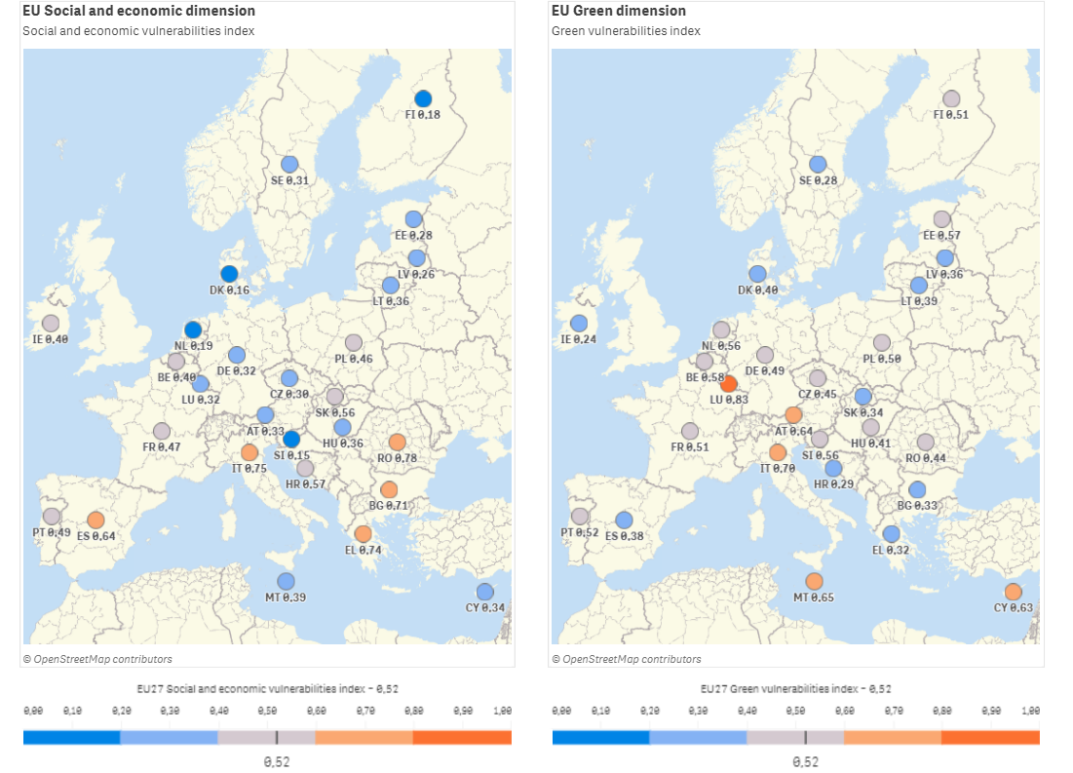
Vulnerability and resilience dashboard: vulnerability
Notes:
resilience is multidimensional and shock dependent
- One of the key features of our framework is the distinction between different capacities that the system may use in reacting to a shock/change. Trying to absorb such shocks and changes and go back to previous state is not the only strategy available and might not be the best one. Depending on the type of shock, on its characteristics the system may better adopt different reaction capacities.
- The two main dimensions of disturbances (both shocks and structural changes) (and hence the resilience to them) are intensity and persistence –This Figure shows the joint role of the two dimensions in identifying the capacity required to sustain a resilient behavior.
- The reaction of the system nay take place by either resisting (absorptive capacity), is shock is not too strong in intensity and persistence, or by adopting a degree of flexibility and making small changes to the system (adaptive capacity), if shock is stronger and persists longer, or, at the limit, when disturbances are severe, it is the ability to undergo a deeper change or transformation (transformative capacity).
Examples:
absorptive capacity relates to stability and resistance, agents absorb the impact of shocks without changing their behavior. E.g. in the financial crisis this is financial support to banks
adaptive capacity requires flexibility, and involves incremental changes to allow agents to continue functioning. E.g. financial crisis this is creating a safety net with BU.
transformation happens when other capacities are not enough. E.g. financial crisis this is creating capital markets union. Transformation is the means of learning from past events and engineering changes to better conditions given the current constraints. It is the opportunity to better handle future crisis
- Different policy actions stimulate different capacities. The JRC framework aims at supporting policy makers in identifying the most effective policy measures, including interventions that help the society to adapt and ultimately transform if needed.
prevention
preparation
promotion
protection
transformation

Slide 15
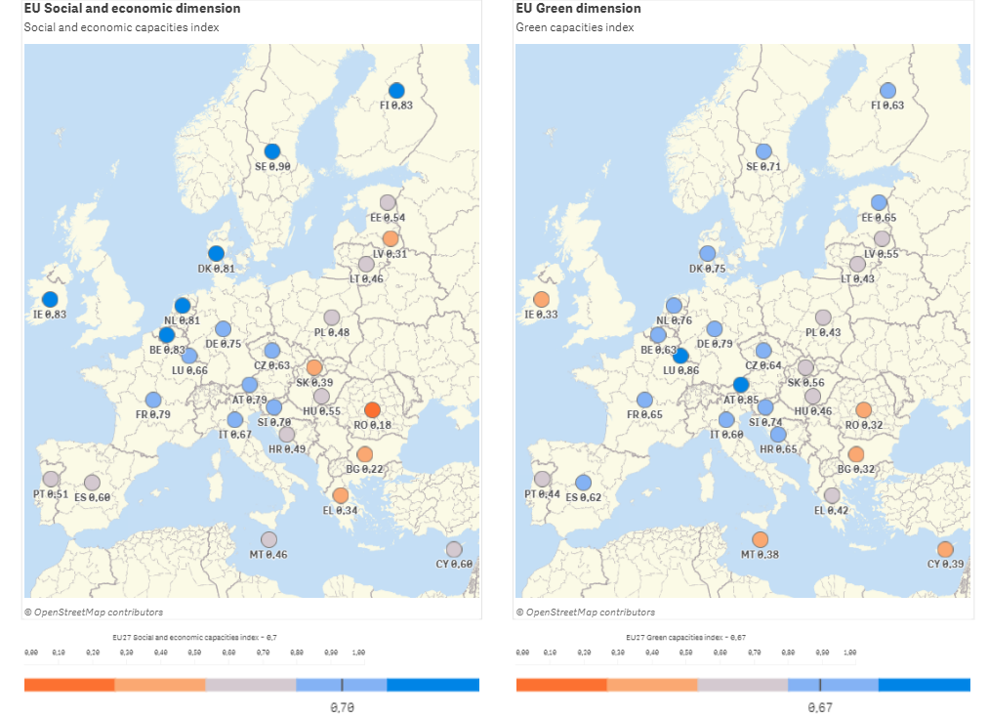
Vulnerability and resilience dashboard: resilience
Notes:
resilience is multidimensional and shock dependent
- One of the key features of our framework is the distinction between different capacities that the system may use in reacting to a shock/change. Trying to absorb such shocks and changes and go back to previous state is not the only strategy available and might not be the best one. Depending on the type of shock, on its characteristics the system may better adopt different reaction capacities.
- The two main dimensions of disturbances (both shocks and structural changes) (and hence the resilience to them) are intensity and persistence –This Figure shows the joint role of the two dimensions in identifying the capacity required to sustain a resilient behavior.
- The reaction of the system nay take place by either resisting (absorptive capacity), is shock is not too strong in intensity and persistence, or by adopting a degree of flexibility and making small changes to the system (adaptive capacity), if shock is stronger and persists longer, or, at the limit, when disturbances are severe, it is the ability to undergo a deeper change or transformation (transformative capacity).
Examples:
absorptive capacity relates to stability and resistance, agents absorb the impact of shocks without changing their behavior. E.g. in the financial crisis this is financial support to banks
adaptive capacity requires flexibility, and involves incremental changes to allow agents to continue functioning. E.g. financial crisis this is creating a safety net with BU.
transformation happens when other capacities are not enough. E.g. financial crisis this is creating capital markets union. Transformation is the means of learning from past events and engineering changes to better conditions given the current constraints. It is the opportunity to better handle future crisis
- Different policy actions stimulate different capacities. The JRC framework aims at supporting policy makers in identifying the most effective policy measures, including interventions that help the society to adapt and ultimately transform if needed.
prevention
preparation
promotion
protection
transformation

Slide 16
Key ingredients of the new fiscal rules
The agreement
The implementation of the agreement:
  Data Sustainability Analysis
  Macroeconomic Imbalances Procedure
  Models to evaluate the impact of investments and reforms on resilience
  Augmented definition of investments (including the social ones)
  Data to evaluate vulneraibility and resilience
Notes:
resilience is multidimensional and shock dependent
- One of the key features of our framework is the distinction between different capacities that the system may use in reacting to a shock/change. Trying to absorb such shocks and changes and go back to previous state is not the only strategy available and might not be the best one. Depending on the type of shock, on its characteristics the system may better adopt different reaction capacities.
- The two main dimensions of disturbances (both shocks and structural changes) (and hence the resilience to them) are intensity and persistence –This Figure shows the joint role of the two dimensions in identifying the capacity required to sustain a resilient behavior.
- The reaction of the system nay take place by either resisting (absorptive capacity), is shock is not too strong in intensity and persistence, or by adopting a degree of flexibility and making small changes to the system (adaptive capacity), if shock is stronger and persists longer, or, at the limit, when disturbances are severe, it is the ability to undergo a deeper change or transformation (transformative capacity).
Examples:
absorptive capacity relates to stability and resistance, agents absorb the impact of shocks without changing their behavior. E.g. in the financial crisis this is financial support to banks
adaptive capacity requires flexibility, and involves incremental changes to allow agents to continue functioning. E.g. financial crisis this is creating a safety net with BU.
transformation happens when other capacities are not enough. E.g. financial crisis this is creating capital markets union. Transformation is the means of learning from past events and engineering changes to better conditions given the current constraints. It is the opportunity to better handle future crisis
- Different policy actions stimulate different capacities. The JRC framework aims at supporting policy makers in identifying the most effective policy measures, including interventions that help the society to adapt and ultimately transform if needed.
prevention
preparation
promotion
protection
transformation

