Slide 1

Regulating Algorithmic Management
Jeremias Adams-Prassl Halefom Abraha Aislinn Kelly-Lyth Sangh Rakshita Six Silberman
University of Oxford
A BLUEPRINT
Notes:
Ack: ERC, team

Slide 2
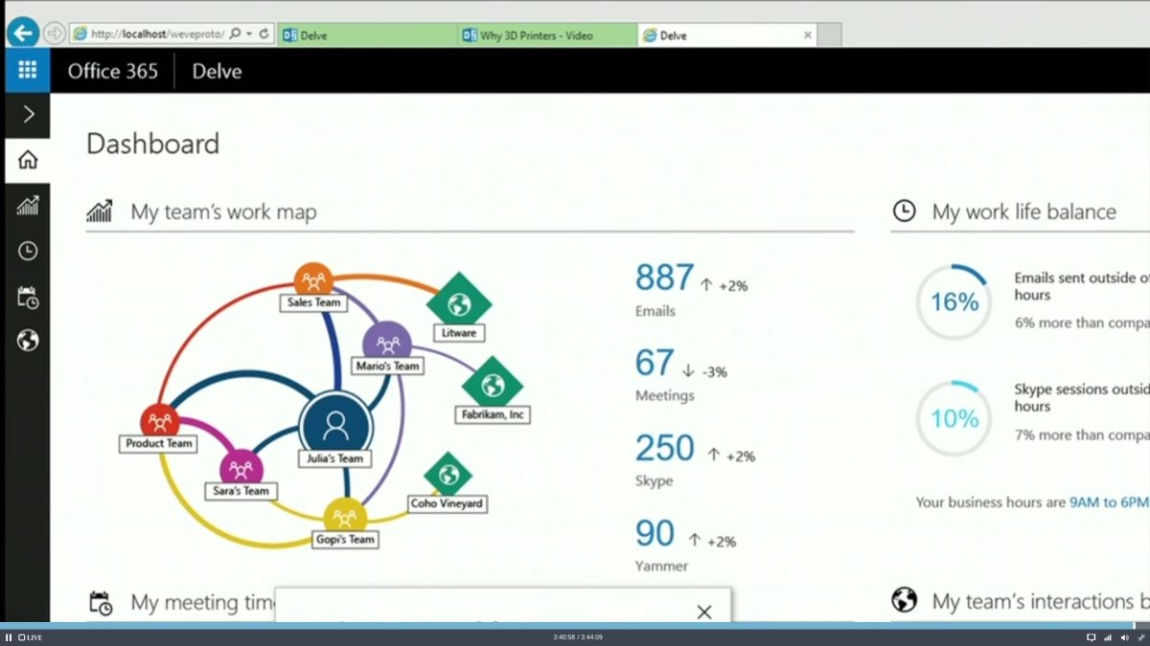
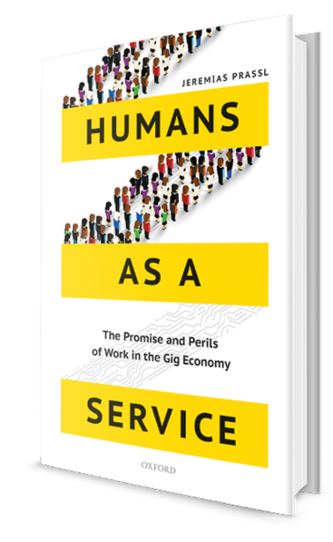
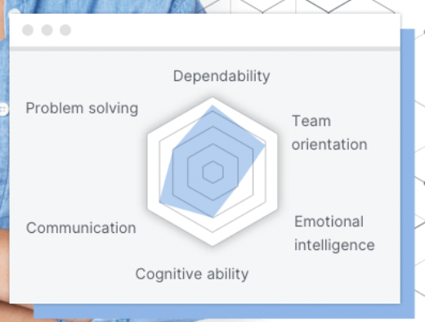
Algorithmic Management
‘AI’ at Work
Augmentation / Automation of Employer Functions
From the Gig Economy to Workplaces across the Socio-Economic Spectrum
Explosive Growth during Covid-19

Slide 3
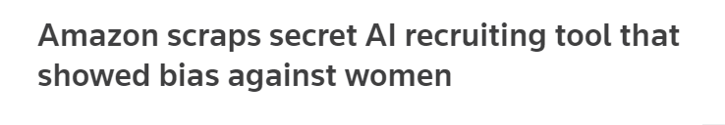
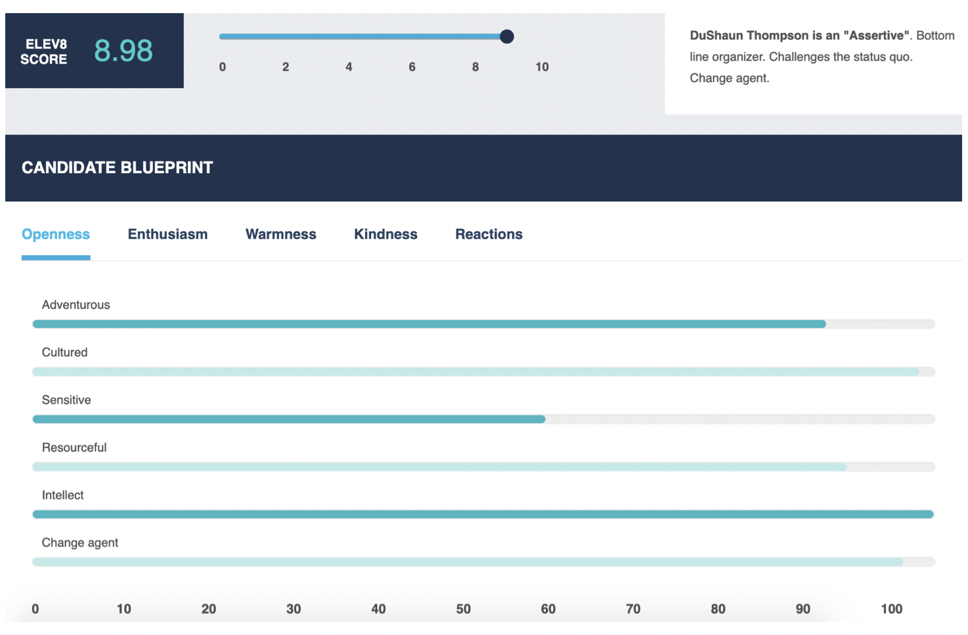
THINGS CAN QUICKLY GO WRONG
Raghavan et al (2019)
Notes:
Need to distinguish at least two types of problems – specific harms, and snakeoil AI (e.g. 30 sec video analysis – essentially random number generator)

Slide 4
TWO FUNDAMENTAL QUESTIONS

Slide 5
HOW FAR CAN Existing LAWS TAKE US? WHERE (AND WHY) ARE new rules required?

Slide 6
How far can existing rules take us?
Notes:
Now - even if ARM is a distinct phenomenon, don’t automatically assume that existing norms should be thrown out

Slide 7
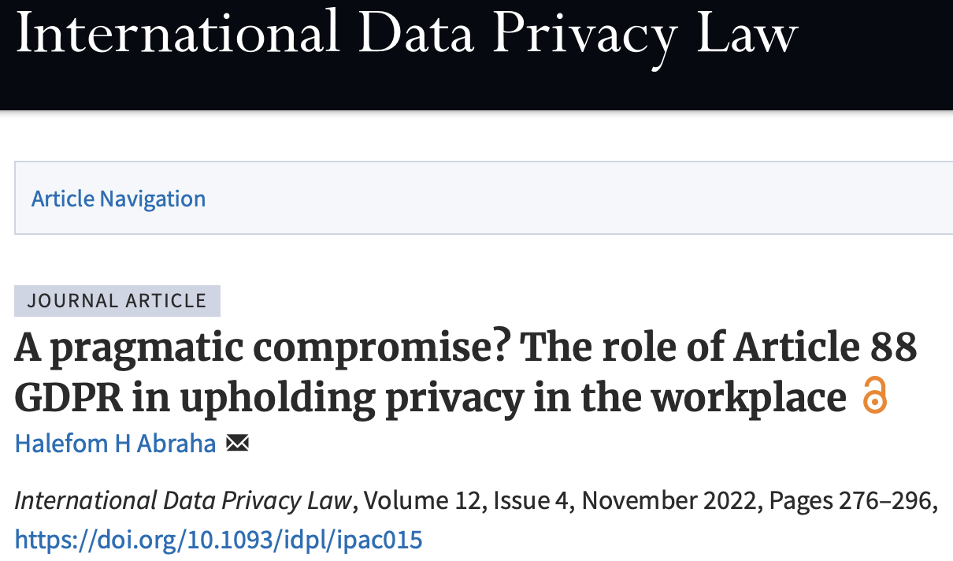
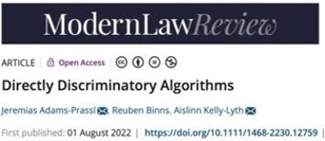
DO NOT GIVE UP ON ESTABLISHED RULES
J Adams‐Prassl, R Binns and A Kelly‐Lyth,
‘Directly Discriminatory Algorithms’
(2023) 86 Modern Law Review 144
H Abraha 'A Pragmatic Compromise? The Role of Article 88 GDPR in Upholding Privacy in the Workplace’
(2022) 12 International Data Privacy Law 276
Notes:
But they have their shortcomings… some inherent in regimes, independent of ARM – our specific question on the other hand is

Slide 8
WHAT ARE NOVEL REGULATORY CHALLENGES?
Notes:
Just b/c something is new, there’s not automatically need for new law
Key Q: are there any novel regulatory challenges
We’ve identified two broad clusters of challenges (these are not mutually exclusive, watertight categories; but they are helpful for thinking about and evaluating different responses)

Slide 9
EXACERBATED PRIVACY HARMS & INFORMATION ASYMMETRIES
PRIVACY HARMS
_ Individual: Reputational & Autonomy _ Collective or ‘Relational’ (Viljoen)
INFORMATION ASYMMETRIES
_ (Tacit) Knowledge Extraction _ Inferences
IA-DRIVEN HARMS
_ Bargaining & Discrimination _ Choice of power vs productivity (Benkler & Bar-Gill)
Notes:
Individual: productivity scores on leaderboards (reputational harm if public; even just watching itself leads to psychological harms – knowing that you’re watched harmful even if not is an autonomy harm, including chilling exercise of individual rights). Warren & Brandeis 1890 on purpose of privacy protection: need DP to protect against informational harm; could do reputational with defamation)
Collective (‘Relational’) Harms – inferences made about group X on basis of data about group Y leaves group X with limited protection, b/c DP is always about data collected about the individual
[NB – in US law, need to show harm; under GDPR, processing is by itself a harm. informational harm (i.h. – loss of control over what I can do with my data)
IA: better data could improve working lives & enhance productivity (e.g. participatory scheduling) ---- BUT instead it’s not necessarily deployed to that end
The result of this are Information-Asymmetry-driven Harms
Hiring: you don’t have information about system used, access to hiring patterns info, info you get from human interaction (Wachter)
Bargaining: career progression (claim to want to leave, but low prediction)

Slide 10
THE DEMISE OF MANAGERIAL AGENCY
Transforming Management
_ Augmentation & Automation _ Full Range of Employer Functions
Loss of Agency
_ Practical Agency: central to Empathy, Flexibility (IFW) _ Moral Agency: Alienation / Dignity Concerns
Loss of Legal Accountability
_ Disintermediated Control, distinct from prevailing bureaucratic structures in the workplace (Kellogg et al) _ Legal Attribution Mechanisms structured around human exercise of managerial prerogative
Notes:
Lack of agency matters b/c it further exacerbates IA harms – e.g. lack of practical agency leaves no space for empathy / flexibility – hotel room assignment
Moral agency: Amazon warehouse – mgt doesn’t know or understand; from the worker perspective leads to alienation and raises dignity concerns
Dignity: particularly important with fully automated systems
Other features traditionally associated with
Legal Attribution: bureaucratic structures rely on humans to make decision; law then relies on Vicarious Liability or (unspoken) ascription to corporate entity to ensure accountability
>>> so review laws: difficulty in locating liability (even with third parties, because of multiplicity of actors in AI supply chain); this difficulty make ex ante / ex post conditioning very difficult – structure incentives for everyone to act responsibly

Slide 11
REGULATING AI AT WORK _ A BLUEPRINT

Slide 12
THE BLUEPRINT
ADDRESSING THE SHORTCOMINGS
_Novel Privacy Harms, Information Asymmetries _Restoring Human Agency
COMPARATIVE SURVEY
_ Academic Analysis, Policy Proposals, … _ Emerging Legislation
POLICY PROPOSALS
_ Eight Options

Slide 13
European labour law journal
Volume 14 No. 2 (June 2023)
Regulating algorithmic management: A blueprint
JEREMIAS ADAMS-PRASSL, HALEFOM ABRAHA, AISLINN KELLY-LYTH, M SIX SILBERMAN AND SANGH RAKSHITA
Algorithmic discrimination at work
AISLINN KELLY-LYTH
Regulating algorithmic employment decisions through data protection law
HALEFOM ABRAHA
Making algorithmic management safe and healthy for workers: Addressing psychosocial risks in new legal provisions
AUDE CEFALIELLO, PHOEBE V MOORE AND ROBERT DONOGHUE
Collective regulation of algorithmic management
ZOE ADAMS AND JOHANNA WENCKEBACH
Algorithmic management: Assessing the impacts of AI at work
AISLINN KELLY-LYTH AND ANNA THOMAS
From access to understanding: Collective data governance for workers
DAN CALACCI AND JAKE STEIN
Between risk mitigation and labour rights enforcement: Assessing the transatlantic race to govern AI-driven decision-making through a comparative lens
ANTONIO ALOISI AND VALERIO DE STEFANO
Fortifying the algorithmic management provisions in the proposed Platform Work Directive
MICHAEL VEALE, M SIX SILBERMAN AND REUBEN BINNS

Slide 14
HARNESSING PROGRESS, EMPOWERING HUMANS

Slide 15
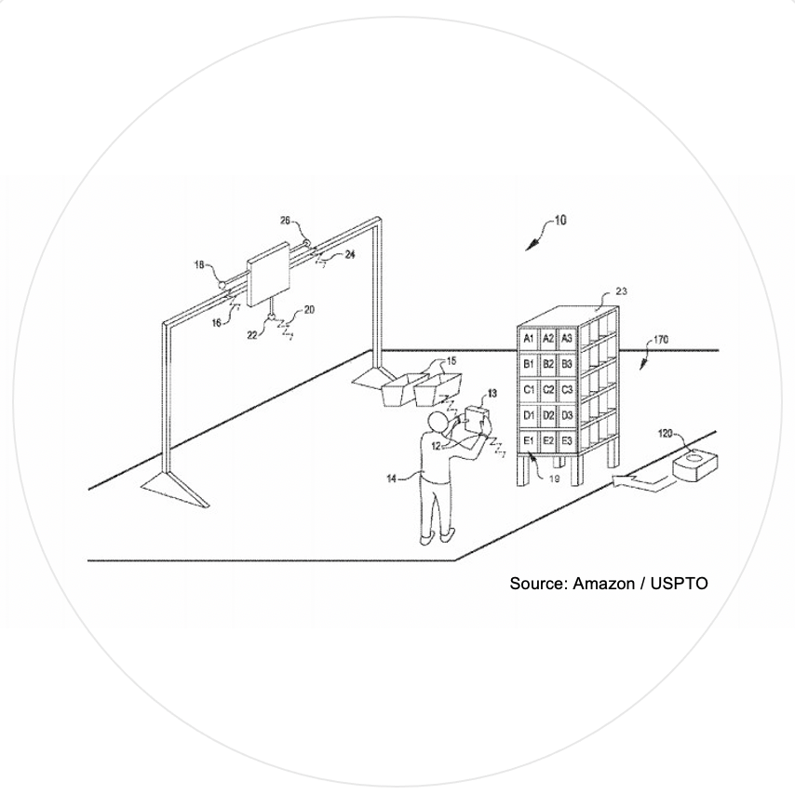
Notes:
Need to empower the humans

Slide 16





THE TEAM
Halefom
Abraha
@Halefom_Abraha
Jeremias
Adams-Prassl
@JeremiasPrassl
Aislinn
Kelly-Lyth
@LawAislinn
Sangh
Rakshita
@Sangh_Rakshita
Six
Silberman

