Slide 1

Bruxelles, 20th April 2015
Competitiveness, Productivity and Growth: Europe’s Challenge
Fredrik Erixon, Director ECIPE
February 21, 2024

Slide 2

Key messages
Europe has problems with economic growth – leading to a slow process of wage and prosperity growth.
Our growth and economic position relative to others is deteriorating.
Focus on productivity growth
Shaping Europe's international economic policy

Slide 3
GDP/Capita (USD 2017 PPP)
Shaping Europe's international economic policy

Slide 4
Growth in GDP per hour worked
Shaping Europe's international economic policy

Slide 5
Contributions to growth in GDP/hour worked
EA-12
US
Shaping Europe's international economic policy

Slide 6
Patent i transversal technologies
Shaping Europe's international economic policy

Slide 7
Human capital: net flows in advanced STEM 2015-2020 (scientific authors)
Shaping Europe's international economic policy

Slide 8
Deteriorating FDI performance
Shaping Europe's international economic policy

Slide 9
The ”Ideas economy”: Ideas cost more
Shaping Europe's international economic policy

Slide 10
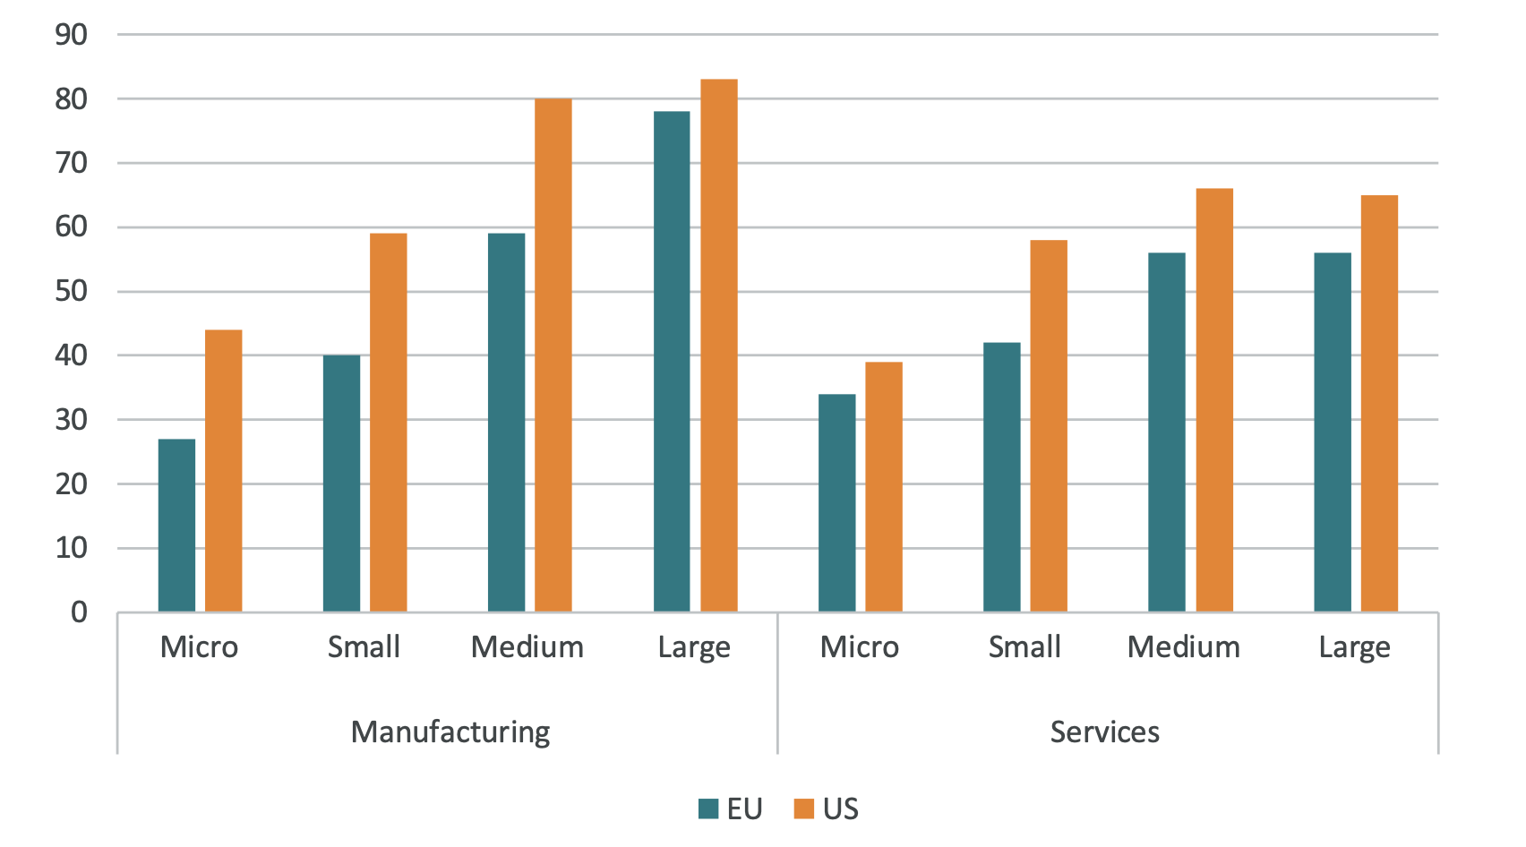
Technology adoption (EU-17)
Shaping Europe's international economic policy

Slide 11
Trade: Extra regional trade intensity index
Shaping Europe's international economic policy

Slide 12
Shaping Europe's international economic policy

Slide 13
EU priorities going forward
Increase R&D spending (125 bn/EUR missing per year in Europe) and focus it.
Reduce cost of innovation (Innovation Union).
Improve incentives for investment.
Stronger convergence in digital markets (single market/digital regulation).
Negotiate trade agreements to improve market access and reduce regualtory costs.
Shaping Europe's international economic policy

Slide 14
Thank you!
Sources for data:
ECB and Federal Reserve (GDP and productivity).
Patents: Bertelsmann Stiftung
Human capital: OECD
FDI: OECD and Eurostat
Trade: TiVA-OECD
Technology/adoption: Eurostat
Shaping Europe's international economic policy

