Slide 1
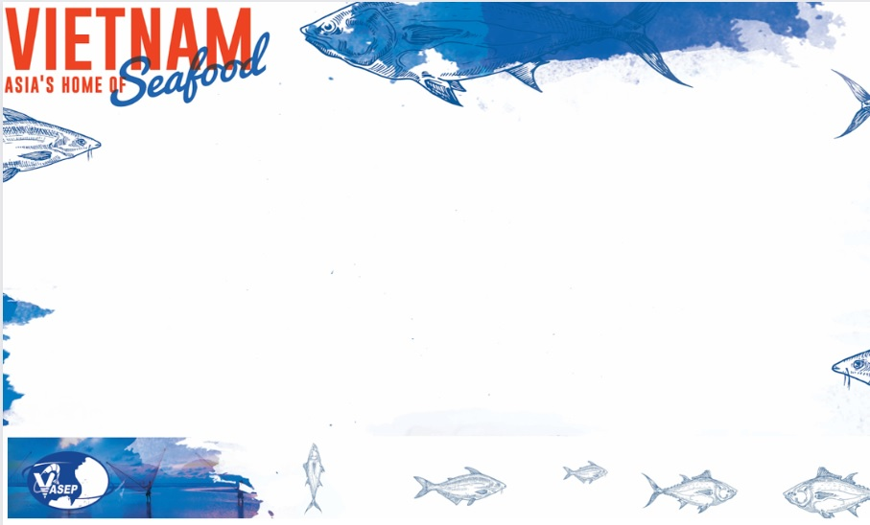
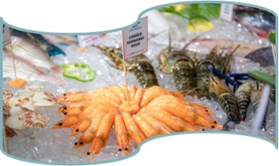
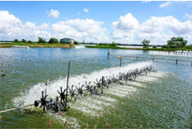
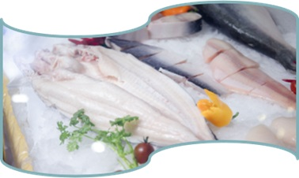
VIETNAM AQUACULTURE SECTOR SUSTAINABLE CERTIFICATIONS
VIETNAM ASSOCIATION OF SEAFOOD EXPORTERS AND PRODUCERS (VASEP)
Presented by: Mr. Nguyen Hoai Nam
Deputy General Secretary of VASEP
Presenter: Le Hang – Communication Director

Slide 2
MAIN CONTENTS
I. VASEP
II. OVERVIEW ON VIETNAM SEAFOOD EXPORTS
III. SUSTAINABLE CERTIFICATIONS
IN VIETNAM AQUACULTURE

Slide 3

I. VASEP INTRODUCTION
Non-governmental organization (NGO)
Establisted on 12th June 1998
Executive Board is seclected every 5 years
Number of members by 2023: 303 companies (Full members: 178; Associated members: 125).
VASEP member companies accounts for 80-84% of Vietnam’s total seafood export turnover
Website: www.vasep.com.vn
Email: vasephcmcity@vasep.com.vn / vasephn@vasep.com.vn
Website: www.vasep.com.vn
Email address: vasephcmcity@vasep.com.vn / vasephn@vasep.com.vn

Slide 4
VASEP MEMBERS: 303 (2023)
Domestic suppliers
26
Finance, Banks
3
Tuna
council
19
Marine products
90
Shrimp
49
Pangasius
39
Others - 116 Service, chemical, Equipment, Technology,…)
State agencies
6

Slide 5
II. OVERVIEW ON VIETNAM SEAFOOD EXPORTS

Slide 6
OVERVIEW ON SEAFOOD PROCESSING AND EXPORTING INDUSTRY OF VIETNAM
Early integration has helped Vietnam's seafood industry qualify for the "No. 1 list" of enterprises allowed to export to the EU since 1999, when only 19 enterprises were granted export codes. Currently, Vietnam has 692 factories with EU export code (an increase of 36.5 times compared to 1999), accounting for more than 81% of the total 847 industrial-scale factories certified to meet food safety conditions.
Vietnam is one of the 3 largest seafood exporters in the world (after China, Norway);
Vietnam is exporting seafood to nearly 170 markets, including the largest and most demanding markets (such as EU, US, Japan, Australia, UK, Korea, China...),
Seafood is in top 10 major export industries of Vietnam, creating jobs and livelihoods for more than 4 million direct workers.
Export turnover generated by Vietnamese seafood enterprises accounts for 92-95% of Vietnam's total seafood export value (FDI companies: 5-8%).
Seafood accounts for 10-12% of the total export turnover of domestic manufacturing industries.
The proportion of Vietnamese private enterprises in seafood export and processing industry accounts for more than 97% - demonstrating a great internal force and effort of the business community to create high added value in context of integration and high competition.

Slide 7
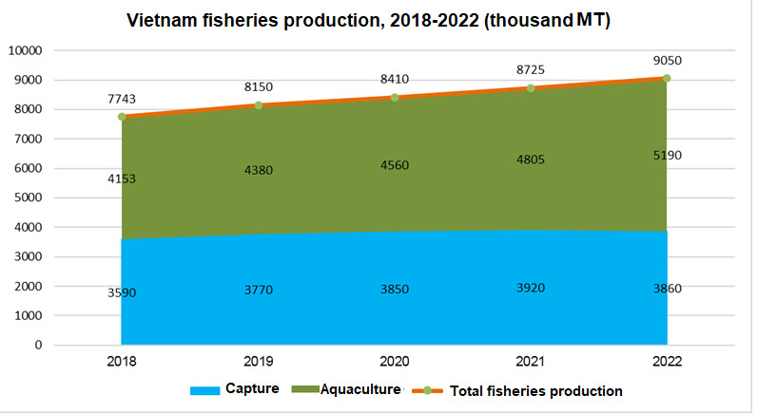
VIETNAM FISHERIES PRODUCTION
Vietnamese fisheries output increased steadily YoY. Aquaculture output tent to sharply rise while capture ouput tend to slow down.
In 2022, aquaculture occupied 57%, capture occupied 53%.
Plan to 2030: aquaculture makes up 70 – 72%, capture accounts for 28-30%

Slide 8
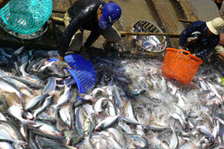
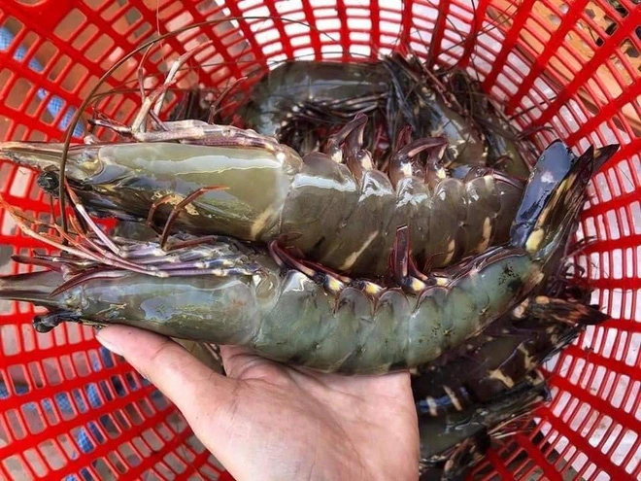
Main aquaculture species in Vietnam in 2022
+ Brackish water shrimp - Farming area: 737 thousand ha - Black tiger shrimp 622 thousand ha, - Whiteleg shrimp 115 thousand ha); - Output: 1.015 million tons Black tiger shrimp: 271 thousand tons Whiteleg shrimp 744 thousand tons. | + Marine farming: - Area 9 million m³ cages 4 million m of marine fish cages; 5 million m of lobster cages. - Total production 717 thousand tons Marine fish: 45 thousand tons of; Lobster: 2.5 thousand tons; Molluscs: 400 thousand tons; Other objects: 270 thousand tons. | + Pangasius: 5,700 ha, Output 1.608 million tons, + Tilapia: farming area is 30,000 ha, Output is 260 thousand tons + Other fish: Output of 1.13 million tons, up 3.2% compared to 2021

Slide 9
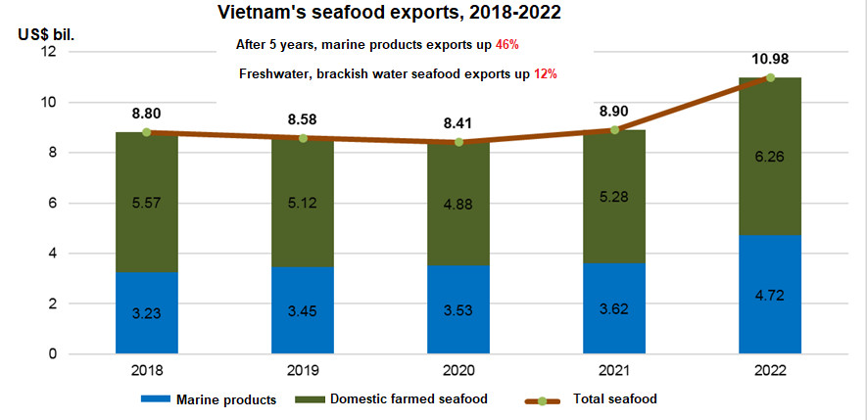
VIETNAM SEAFOOD EXPORTS
In 2022, the exports of wild-caught and farmed seafood (tuna, cephalopod, anchovies, mahi mahi, crab, clam, lobsters, marine shrimps, etc.) reach US$4.7 billion, accounting for 43%, the value proportion is increasingly high compared to previous years.
Aquaculture products including whiteleg, black tiger shrimp, pangasius... reached US$6.26 billion, accounting for 57%, the proportion tends to decrease

Slide 10
VIETNAM SEAFOOD EXPORTS, JAN – SEP 2023
Vietnam seafood exports, Jan – Sep 2023
Products | Value (US$ mil.) | Vs. same period 2022 (%) |  | Markets | Value (US$ mil.) | Vs. same period 2022 (%)
Shrimp | 2,525,523 | -25.6 |  | CPTPP | 1,754,916 | -19.8
Pangasius | 1,352,311 | -31.3 |  | The US | 1,167,901 | -34.3
Tuna | 616,903 | -23.6 |  | China & HK | 1,137,671 | -16.3
Other fish | 1,390,551 | -8.2 |  | Japan | 1,102,316 | -13.0
Cephalopod | 477,327 | -14.2 |  | EU | 714,617 | -31.5
Mollusk shells | 98,421 | -10.6 |  | S. Korea | 567,919 | -21.0
Other mollusk | 3,994 | -18.6 |  | ASEAN | 499,360 | -15.1
Crabs | 136,612 | -18.0 |  | ARAP | 223,781 | -8.1
Total | 6,601,642 | -22.6 |  | Total | 6,601,642 | -22.6

Slide 11
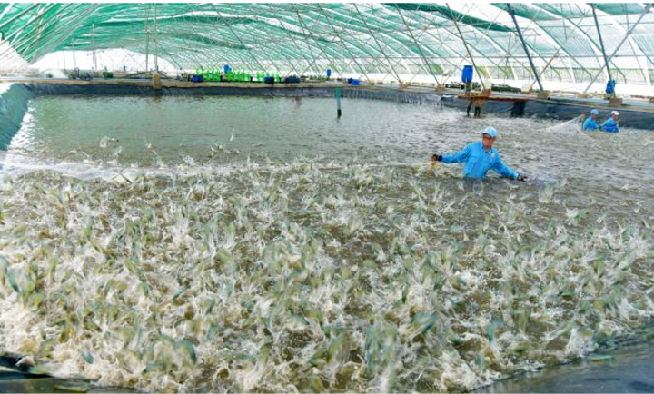
III. SUSTAINABLE CERTIFICATIONS IN VIETNAM AQUACULTURE

Slide 12
OVERVIEW ON SUSTAINABLE CERTIFICATIONS IN VIETNAM AQUACULTURE
Vietnam has great potential in developing aquaculture, especially marine and brackish water farming: dynamic and active in applying certifications and accessing the markets.
Vietnam has currently completed the system of legal frame on i) Seeds; ii) Aquatic food; iii) Food hygiene and safety; iv) Environmental management in aquaculture; v) Sustainable farming management; vi) Traceability...
There are currently about 14 aquaculture certification systems being applied in Vietnam. But mostly ASC, BAP, GlobalGAP, VietGAP, as market driven.

Slide 13
No | Certifications | Species applied | Main markets | Consuming opportunities
1 | BAP | Shrimp, tilapia, pangasius | The US | Retailers, restaurant chains and food service in North America (Wallmart, Norpad)+ UK
2 | GLOBALGAP | Shrimp, tilapia, pangasius | EU | Retailers, restaurant chains and food service in North Europe, the US, Japan
3 | FOS | Shrimp & prawn, tilapia, pangasius | EU | Retailers, restaurant chains and food service in EU (Italy, Switzerland, Germany, France)
4 | Organic aquaculture (EU) | Shrimp & prawn | EU | Only 01 brand for all EU countries -> easily recognizable to consumers>50% • Upon request from retailers and restaurant chains in the Northern EU (Germany, UK, France ,Sweden, Denmark…)
5 | ASC | Shrimp, tilapia, pangasius, mollusk | EU | Commitments of some European retailers (AHOLD, MIGROS, METRO, NORDIC, POPPEN…); Japan (AEON)….
6 | SELVA | Shrimp & prawn | Switzerland, EU | Consumed mainly in Blue You's system
7 | NATURLAND | Shrimp & prawn | EU | Consumed mainly in Northern European countries

Slide 14
No | Certifications | Species applied | Main markets | Consuming opportunities
8 | ASIC | Shrimp & prawn | The US | Support commitments of retailers: Blue Apron – USA; Rubicon Resources – USA; Cheesecake Factory – USA; Santa Monica Seafoods – USA; Seacore Seafoods – Canada; Ecohub Global – Singapore
9 | BIO SUISSE | Shrimp & prawn | EU | Switzerland
10 | USDA NOP | Shrimp & prawn | The US, Japan
11 | VietGap | Aquaculture species | Vietnam | Supermarkets and stores in Vietnam
12 | Seafood Watch | Aquaculture species | North America
13 | MSC | Clams (farmed from natural seed) | EU, America , Japan, China | MSC products are favored in many markets in over 100 countries around the world
14 | FAIR TRADE | Clams, Shrimp & prawn … | EU, America | Products are linked in the chain and have equitable benefit sharing within the chain

Slide 15
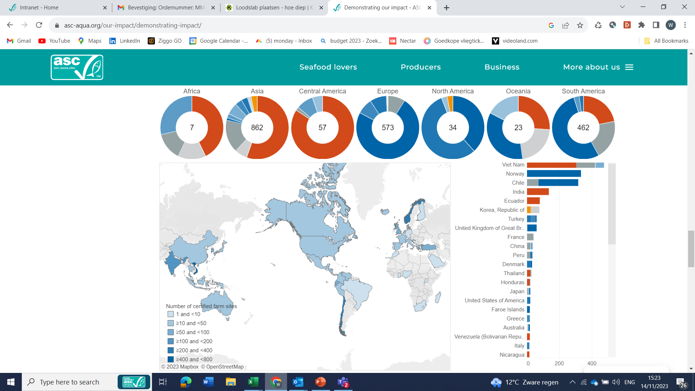
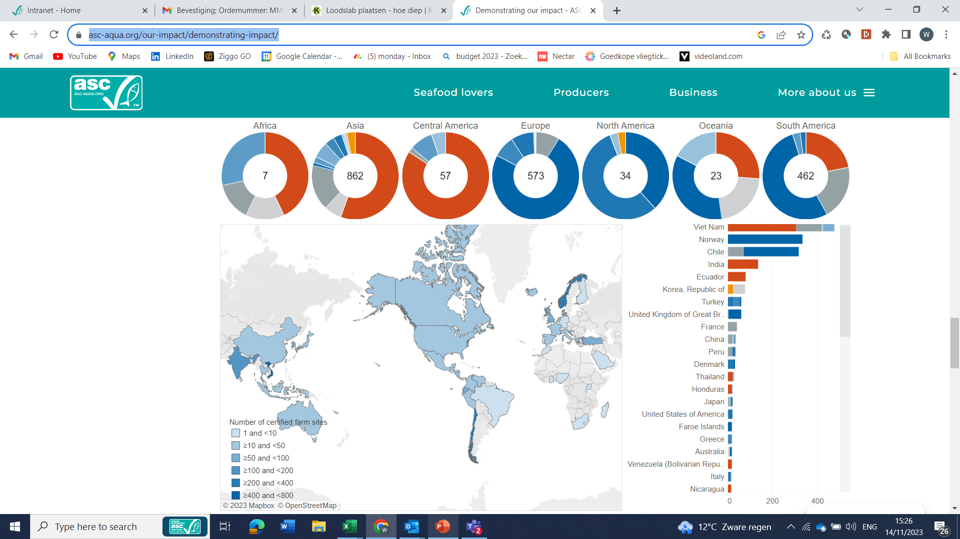
Vietnam is ASC’s No.1 country in amount of farms certified
Aquaculture Stewardship Council
Shrimp → Vietnam: 306 farms
Salmon
Pangasius→ Vietnam 51 farms
Bivalves → Vietnam 114 farms
Link on ASC website with all information: https://asc-aqua.org/our-impact/demonstrating-impact/
ASC’s statistics on certified farms is an evidence for Vietnam’s commitments on sustainable aquaculture.

Slide 16
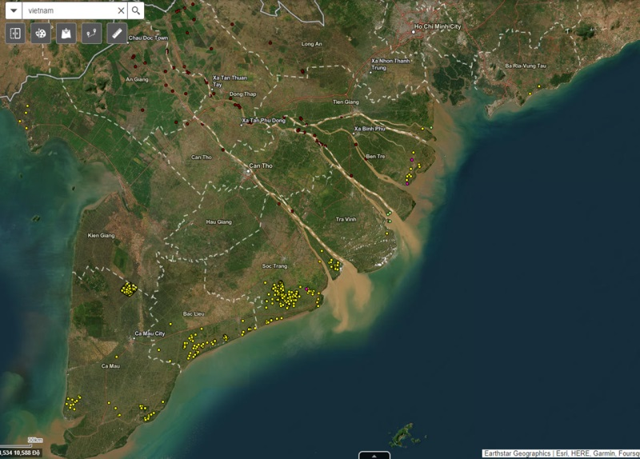
Vietnam's seafood industry participates in international market integration and accesses and applies sustainable certification systems such as ASC, Global Gap, BAP, FoS, MSC... for many years. That brings significant opportunities for Vietnamese seafood products in markets, because it affirms the reputation, quality, responsibility and commitment of Vietnam's seafood industry.
Vietnam has determined that sustainable development is an inevitable trend, so in the future, certification standards as well as sustainability-related requirements such as responsible production and traceability, social responsiblity, environment responsibility, welfare, food safety... will be mandatory, not voluntary.
ASC certified farms in Vietnam on map

Slide 17
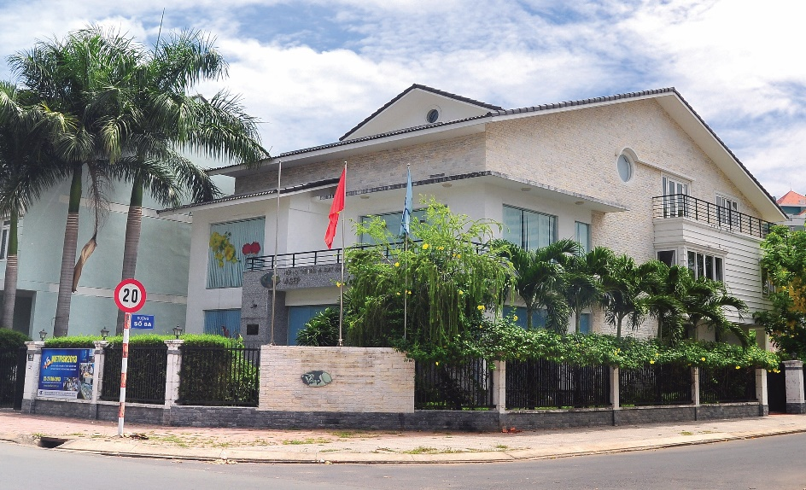
Vietnam Association of Seafood Exporters and Producers (VASEP)
Head office: No 07 Nguyen Quy Canh Str,An Phu Ward, Thu Duc City, HCMC
Tel: +84 8 6281 0430 Fax: +84 8 6281 0347
Rep.office : No 10, Nguyen Cong Hoan Str, BaDinh Dist, Hanoi
Tel: +84 4 3771 5055 Fax: +84 4 3771 5084
Portal: www.vasep.com.vn

Slide 18


